Slide 1
Business strategies case study
Family business planning
Presenter’s name
The presenter’s title goes on this line
For financial professional use only. Not for distribution to the public.

Slide 2
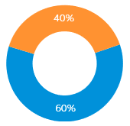
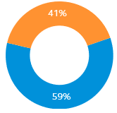
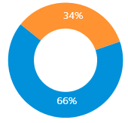
Take advantage of a growing market opportunity
Business ownership*
Non family-owned/ Family- owned
2015
2017
2019
* From Principal Business Owner Market Study: The Harris Poll conducted 1,020 online interviews from Jan. 7 through Jan. 25, 2019. Harris Poll also conducted the 2015 and 2017 surveys for Principal Financial Group.
Notes:
Family-owned businesses account for a significant portion of small- to medium-sized businesses in the U.S.
In our 2019 Principal Business Owner Research study, two-thirds of the 1,020 business owners surveyed indicated their business is family-owned.
This represented a noticeable increase over the previous two surveys.
And many of these businesses need planning help.

Slide 3
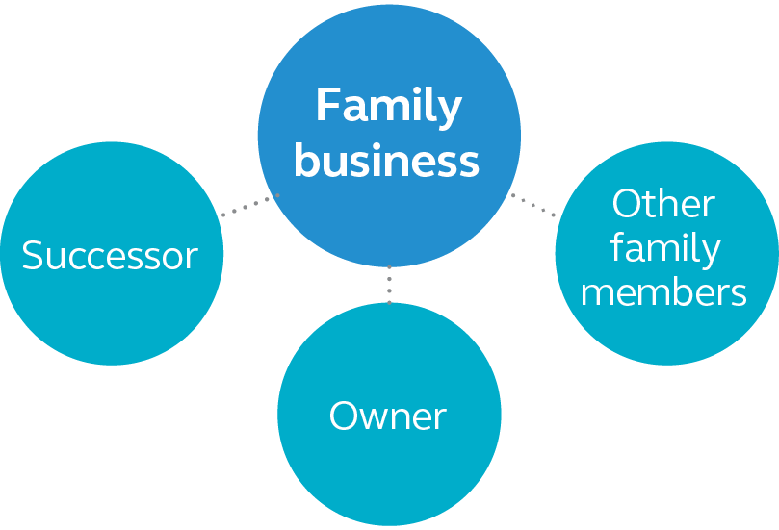
Owners often must balance competing needs
Leave healthy business to support itself and successor
Provide sufficient retirement income for exiting owner
Assure other family members of equitable inheritance
Notes:
The most challenging part of an owner exiting his or her family business is balancing the needs of all parties, including how to:
provide sufficient retirement income for exiting owner,
leave a healthy business to support itself and your successor, and
assure other family members of an equitable inheritance.
You can help your business owner clients plan for these events to help ensure a smooth transition out of the business.

Slide 4
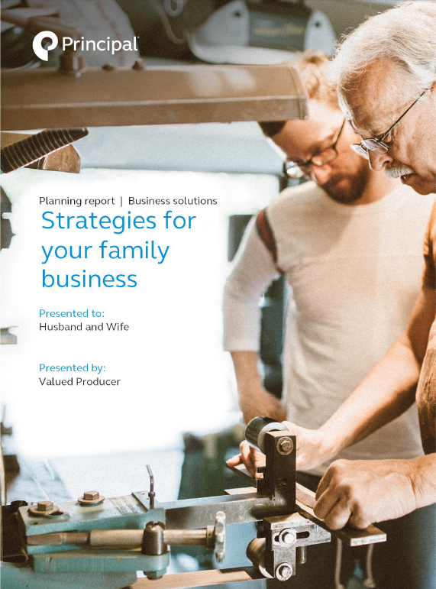
Common business planning strategies
Buy-sell and succession strategies
Buy-sell plan and funding
Succession plan and funding
Key person protection
Key person retention
Retirement income
Retirement analysis
Supplemental income
Chronic illness protection
Estate planning
Wills & trusts
Inheritance equalization
Estate taxes
Gifting techniques
Notes:
When working with family businesses there are several strategies that will likely be discussed. Here are some of the most common.
Review slide.

Slide 5
Case study

Slide 6
Client profile
Family profile
Husband 59, wife 57
Four children (ages 29, 31, 33, 35)
Business profile
Construction company (LLC)
Successors: two of the children (31, 35)
Goals
Transfer business to children in 10 years
Treat heirs fairly
Determine retirement readiness for parents (current owners)
Determine potential federal estate tax exposure
Notes:
Let me take you through a recent case to show you how simple the process can be.
Read overview of client profile.

Slide 7
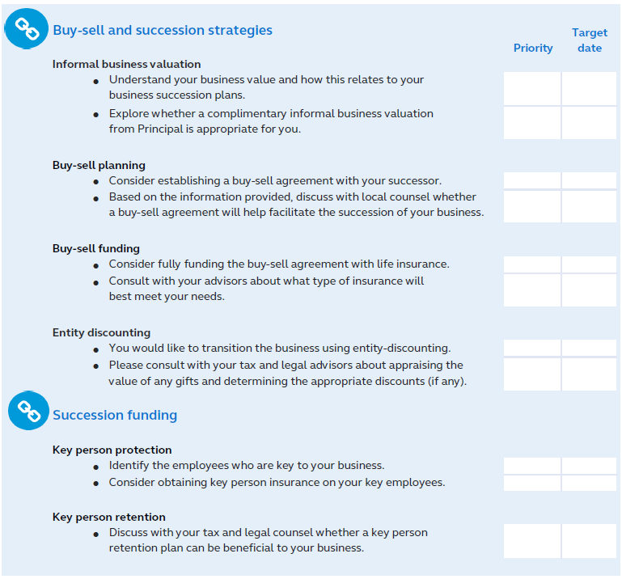
Customized planning considerations
Notes:
In this case, we discussed succession strategies for the client first. The Family Business Planning Report from Principal is customized to the client and helped to identify succession as a priority.
This is a view of the priority checklist used in every report.

Slide 8
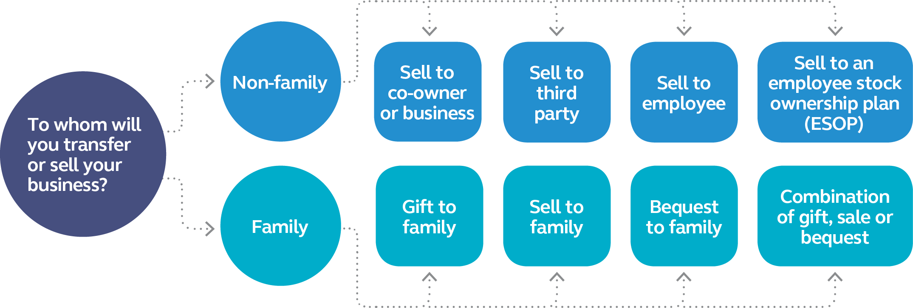
Succession plan considerations:
Who? When? How?
Notes:
There are many options to enable the successful transfer of a business, but it’s important for the owner to have a plan to exit the business on his or her terms—no matter what the circumstances.
Key things to discuss with the owner include:
Who will you sell or transfer the business to?
When do you want to transition out of the business?
How will you generate the income you need for estate liquidity, succession strategies, and replacement income after your working years?

Slide 9
Among owners of family businesses with a succession strategy, 42% plan to leave or sell the business to family.*
* 2019 Principal Business Owner Market Study by the Harris Poll Panel using 1,020 online interviews from Jan. 7 through Jan. 25, 2019.
Notes:
The results of our recent business owner research show that among family business owners with a succession strategy, the most popular plan is to leave the business to family.
When this is the goal, there are clear steps you can suggest they take to ensure a smooth transition.
Read slide.

Slide 10
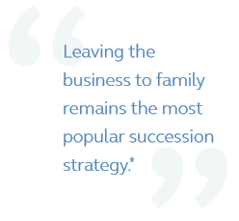
Succession strategies
Topics to discuss with your clients
How will I transfer my business to the next generation?
Who will own and control my business?
How do I minimize transfer taxes?
Steps they can take
Talk with family and business partners about the business’s future.
Determine value of the business.
Select a buy-sell agreement.
Plan for the transition expenses.
Document the agreement.
* 2019 Principal Business Owner Market Study by the Harris Poll Panel using 1,020 online interviews from Jan. 7 through Jan. 25, 2019.
Notes:
When transitioning the business to a family member or members is the goal, there are clear steps you can suggest they take to ensure a smooth transition.
This is an important process, as many haven’t taken the time to start planning.
Read slide.

Slide 11
Find the value of the business
The client provides the fair market value of the business; or,
Principal® provides a complimentary informal business valuation.*
* Available for many types of businesses.
Notes:
And, of course, in order to determine price, you need to know what the value of the business is and ensure it is addressed and kept current in the buy-sell agreement. The client can either provide the fair market value of the business to us, or Principal can provide an informal business valuation to keep the planning process moving forward.
Review slide.

Slide 12
Implement a buy-sell arrangement
How cross purchase buy-sell works
An agreement is put in place.
Each owner purchases insurance on each other owner.
Each owner is premium payer and beneficiary of policies owned.
Upon triggering event, remaining owners purchase business interest of departing owner using policy cash values or benefits from the policy.
Notes:
Transitions are more successful when an owner has an established plan for departure—whether expected or unexpected.
A buy-sell agreement can help the owner achieve this. In this case, the client had a cross purchase buy-sell agreement in place.
Review slide.

Slide 13
Top funding vehicles for owners who have transition plans*
Business cash flow 59%
Life insurance44%
* 2019 Principal Business Owner Market Study by the Harris Poll Panel using 1,020 online interviews from Jan. 7 through Jan. 25, 2019.
Notes:
An important element of a transition plan is to ensure proper funding is in place.
Having necessary funding available in the right amount, in the right place and at the right time is important for a succession strategy to be successful.
Several funding options are available to clients, each with pros and cons.
The main considerations for which method is appropriate for the situation is timing of liquidity and cost.
Our Business Owner Market Study shows the top two vehicles for those who have plans in place are business cash flow and life insurance.
Insurance (life and disability) is often used because it provides liquidity when it’s often needed the most—at the death or disability of an owner.

Slide 14
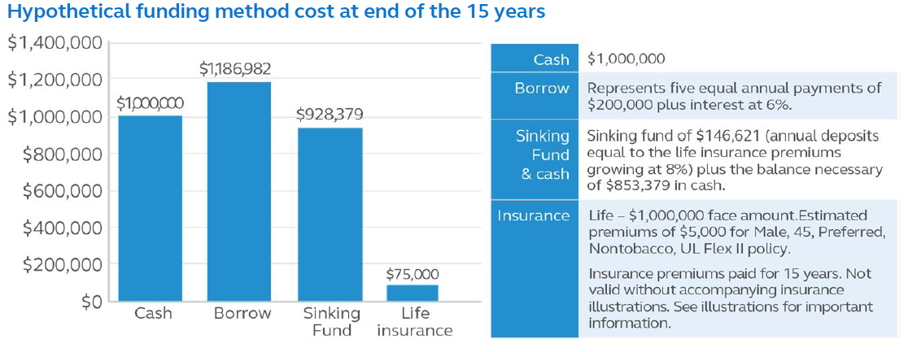
Buy-sell funding
Notes:
Having necessary funding available in the right amount, in the right place and at the right time is important for a succession strategy to be successful. There are several funding options available to clients, each with pros and cons.
The Family Business Planning proposal shows your clients an example of how the costs of the different options can vary.
Read slide.

Slide 15
Common business transfer methods
Lump sum payment
Installment sale
Interest only sale
Part gift, part sale
Employee Stock Ownership Plan (ESOP)
Notes:
Once a buy-sell agreement is in place and you’re looking at funding the buy-sell agreement, it’s important to consider how the sale will take place so they’re prepared, from a funding perspective, to handle the payment transactions.
Lump sum payment – Oftentimes, the buyer finances part of the purchase through a 3rd party lender.
Installment sale – The buyer makes a down payment, and the balance is paid on a predetermined payment schedule.
Interest only sale – The buyer makes a down payment, then pays the seller interest for a specified period of time and makes a balloon payment at the end.
Part gift, part sale – In a business transaction between family members, the owner typically isn’t looking to maximize the sale price. But the owner may not want to just give the business away either. With this structure, the owner can accomplish both goals.
ESOP – Enables an owner to establish an employee-owned company that offers a flexible, tax-favorable way to exit the business, provide retirement benefits, and retain and motivate employees.

Slide 16
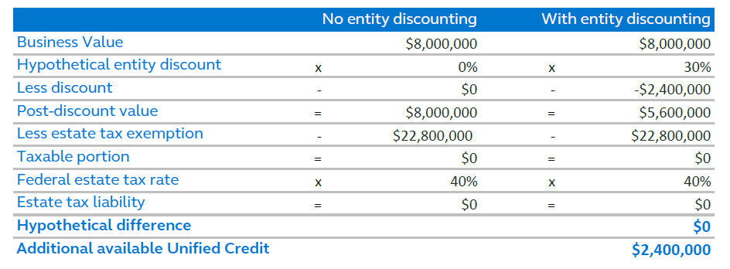
Succession strategies – entity discounting
Notes:
Sometimes, as is the case in many family business transactions, discounting strategies can be used when the transition is to a family member. Here’s an example of how this was used in our recent case.
Review slide.

Slide 17
Retirement income planning
Topics to discuss with your clients
What retirement income resources will I have and how will they fit my needs?
What is the impact to my retirement income from each resource?
Will my resources meet my retirement income goal?
Steps they can take
Discuss expectations with family and business partners.
Determine when your role will change.
Calculate your retirement income needs.
Create a plan to close any retirement income gaps.
Notes:
It’s great to consider the use of entity discounting to potentially decrease the price when transferring the business to a family member. But the exiting owners will also want to think about how the sale price impacts their own income going into retirement. Have they planned sufficiently? How much will the sale of the business contribute to their retirement? Also, retirement could mean slowing down, not walking away. The next generation will be doing more and earning more from the business. Does the existing owner have qualified plans or other assets in place to provide that income stream? And how might an unexpected illness or injury impact retirement income?
Review slide.

Slide 18
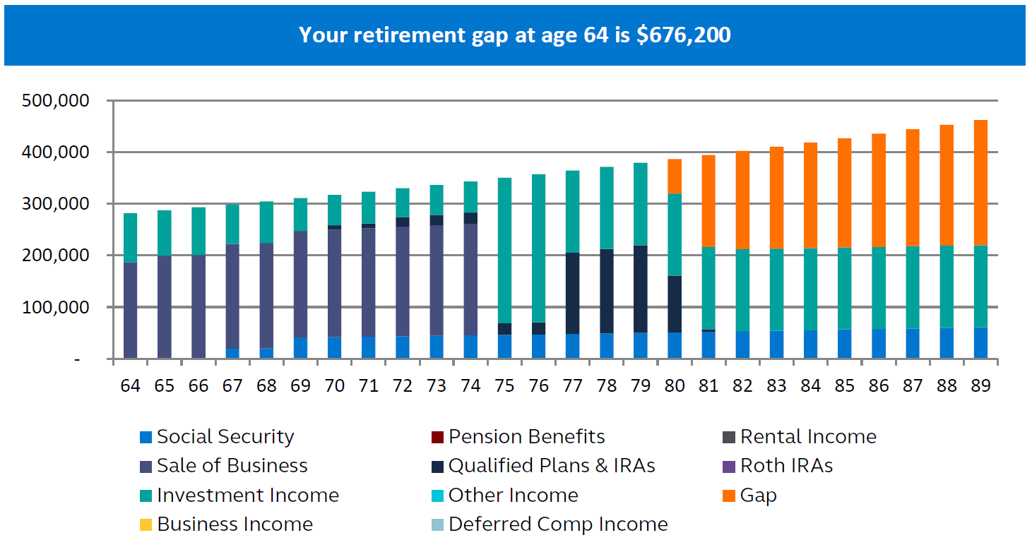
Determine if there’s a retirement income gap
Notes:
Our Family Business Planning Report addresses the retirement income sources of the exiting owner. We gather information around the various sources they may have available to provide retirement income such as Social Security, the sale of the business, rental income, and qualified plans and other investments, to determine any gap in their retirement income needs.
Review slide.

Slide 19
Protection and your retirement income
Notes:
Life insurance is a good fit with many retirement planning strategies. People often forget that not only do they need to have an adequate source of income through retirement, but they also to have to protect that income and protect themselves and their family from unforeseen events that could impact their ability to sustain their standard of living through retirement. Let’s review a couple of scenarios from the handout I provided.
Suggested Handout: Life Insurance and Retirement (BB11982)
There are several products to choose from. Let’s take a look.
Review slide.

Slide 20
An accumulation story clients will love
Principal Indexed Universal Life Accumulation IISM
Provides attractive cash value growth potential without direct participation in the market
Features index-linked account options plus a fixed account
Two policy loan options
High early cash values available for business-owned/ business-sponsored policies
Guaranteed account value enhancement in yrs. 11+
Accelerated and multi-life underwriting available
Key riders: Chronic Illness Death Benefit Advance, Cost of Living Increase, Life Paid-Up, Waiver of Monthly Policy Charge
For financial professional information only. Not for use with the public.
Notes:
Let me share a product with you that met the needs of this particular client we’re discussing.
The product target market was in sync with the clients we were working with. They met the target age and max-funded the policies because they wanted cash value growth. But they were adverse to participating directly in the market.
Review slide.
This product is a good fit for several reasons:
Retirement planning for the incoming owners
Business owner retirement planning for the exiting owner
Putting a retention plan in place for some of their most valued employees

Slide 21
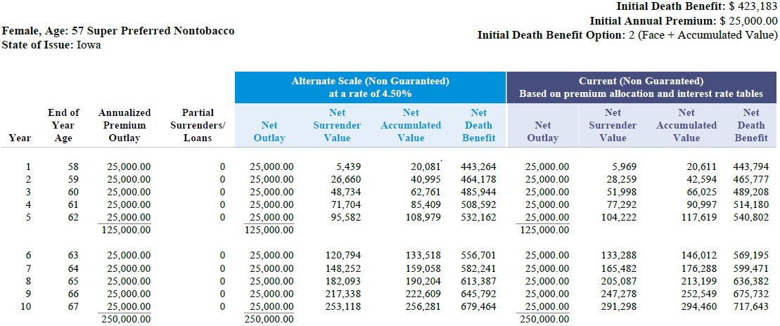
Retirement income - contributions
Notes:
So, let’s take a look at a product illustration to show how this product worked well for the client.
Review slide.
Hand out full illustration to producer for review.

Slide 22
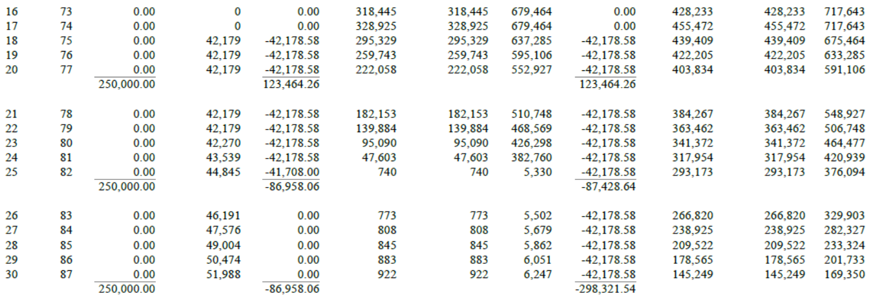
Retirement income - distributions
Notes:
It accumulated income well. Now, let’s take a look at how it will work when the clients start taking distributions in retirement.
Review slide.

Slide 23
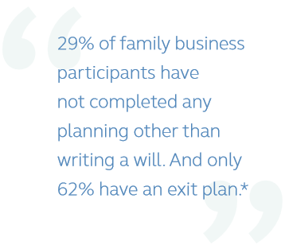
Legacy & estate planning
Topics to discuss with your clients
How do I protect my assets while I’m alive?
Do I use a gift, bequest, or discount to reward my successor’s efforts?
How can I be fair to my other heirs?
Steps they can take
Talk openly with family and business partners about your intent for the business.
Document your plan.
Communicate with executors of your estate.
Regularly revisit and update your plan.
* 2019 Principal Business Owner Market Study by the Harris Poll Panel using 1,020 online interviews from Jan. 7 through Jan. 25, 2019.
Notes:
Once we had their retirement plan in place, they wanted to talk about their estate planning needs. For these clients, deciding where assets go when they’re gone was a tough, but important decision to make. The discussion we initiated was also provided in the Family Business Planning Report, and it’s outlined here.
Review slide.

Slide 24
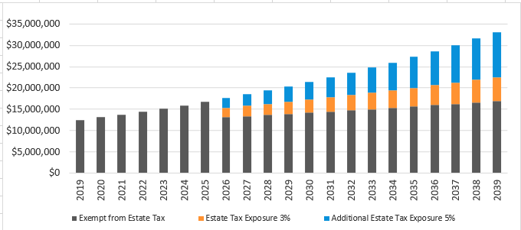
Legacy & estate planning – estate tax analysis
Notes:
Here’s an analysis of their estate tax scenario. As you can see, even if a client doesn’t appear to have an estate tax concern currently, they may have one in the future depending on their age.
If they have insufficient funds to cover their federal estate tax liability, it may be necessary for them to liquidate business assets.
So, they should consider techniques to minimize potential estate and inheritance taxes.
Permanent life insurance can be used to provide liquidity to help pay any federal estate taxes.

Slide 25
Estate tax – funding considerations
Notes:
Life insurance can certainly play a role in many estate planning strategies. The key is to determine which product is a good fit for each individual situation and client. One product may not be the solution to all of your client’s estate planning needs. Many clients use a survivorship product to meet these needs as well. Guaranteed UL can provide security and certainty for these situations.
Review slide.

Slide 26
Two insureds, one policy
Principal Survivorship Universal Life Protector IISM
No-lapse guarantee up to lifetime on two insureds
Flexibility to dial in guaranteed coverage period and premium duration
Seven classes of uninsurable/opt-out underwriting
Accelerated underwriting available
Two term policies can be converted to SUL coverage
All guarantees are based on the claims-paying ability of the issuing insurance company.
For financial professional information only. Not for use with the public.
Notes:
Survivorship UL is our guaranteed UL product based on the lives of two individuals. It pays out after both insureds have passed away.
Review slide.

Slide 27
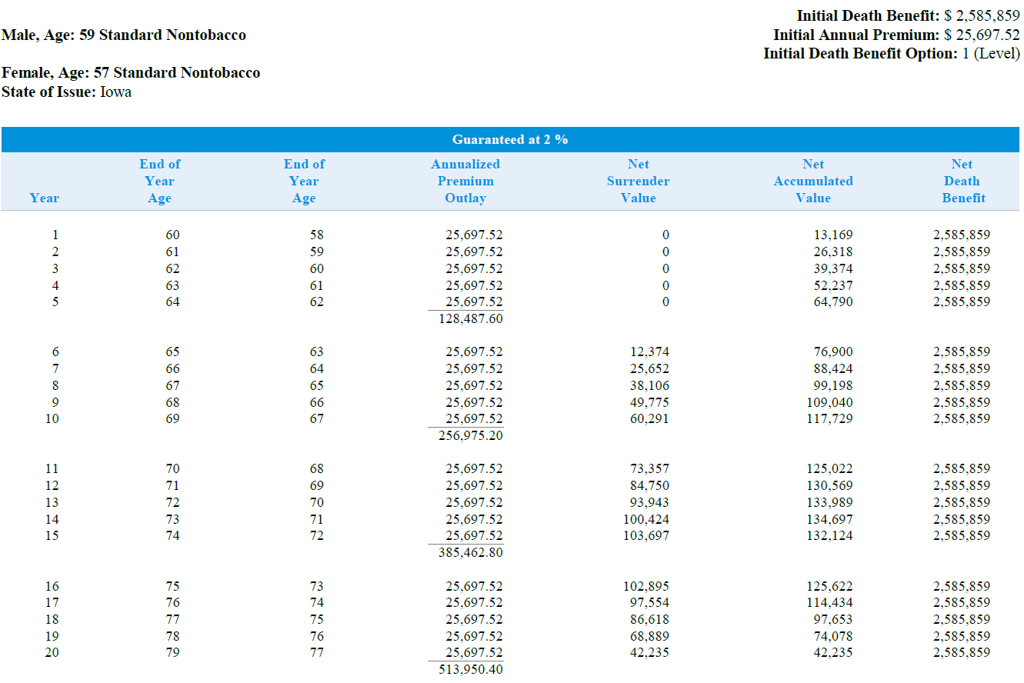
Guaranteed coverage provides certainty for the estate
Notes:
Here’s an example of how a Principal Survivorship Universal Life Protector IISM (SUL Protector II) policy worked for our clients.
Review slide.
Handout should include full illustration.

Slide 28
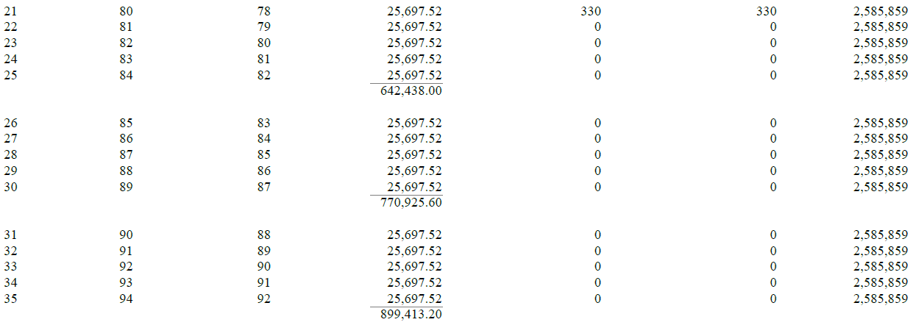
Guaranteed coverage provides certainty for the estate, cont.
Notes:
Here’s the continued review of the policy illustration.
Review slide.

Slide 29
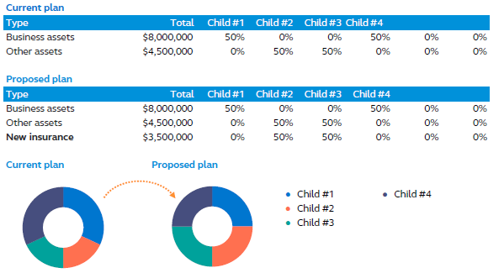
Inheritance equalization can create a fair and equitable distribution
Notes:
Lastly, we like to look at inheritance equalization when discussing estate planning, particularly with family business owners. Many times, not all of their children are involved in the business. That can lead to challenges when trying to be “fair” with all children through a legacy or estate plan. Let’s review the situation with our case. As you may recall, only child 1 and 4 were involved in the business. Children 2 and 3 were not. So, if we look at the estate plan as it was, the owners intended to leave the business to the two children who would be running it and leave their other assets to the two children who were not in the business. However, this is generally never an “equal” scenario, but with a little planning, it can be a “fair” scenario.
Review slide.

Slide 30
Solutions and target premium
IUL Accumulation
$25,000 premium
$12,446 target premium
SUL Protector II
$25,698 premium
$29,408 target premium
Additional planning
Inheritance equalization
Key employee retention
Personal planning for both generations
Notes:
Read slide.

Slide 31
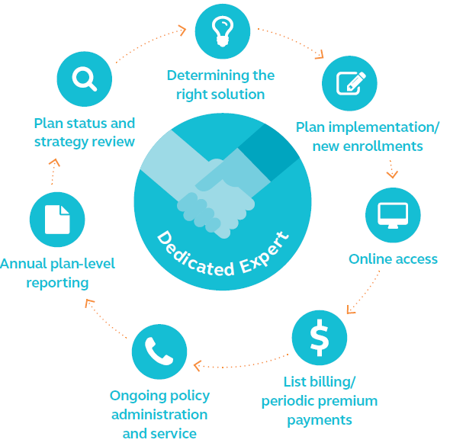
Notes:
As you can see, the Family Business Planning Report is comprehensive and customized to each client’s situation. We offer other reports that provide a similar level of value, such as our Business Owner Retirement Analysis, Agribusiness Planning Solutions Report and Complimentary Business Planning Solutions (informal business valuation and buy-sell review services).
We also offer plan-level administrative services.
Review slide.
In our years of focus and success in the SMB market, we’ve identified some characteristics of businesses who we’ve seen embrace the solutions we’ve offered through our business insurance platform.
They include:
Established businesses (operating 10+ years)
$1M - $10M in annual revenue
1-30 employees
Industries: Professional, Scientific and Technical Services, Manufacturing and Construction

Slide 32
Let’s connect
Call Business and Advanced Solutions at 833-803-8345, or your Life or Business Market RVP
Visit us at advisors.principal.com
For financial professional use only. Not for distribution to the public.
Notes:
[Optional – If time allows, you can offer a Q&A at the end of the session.]
Are there any questions I can address for you before we go?

Slide 33
Principal National Life Insurance Company and Principal Life Insurance Company, Des Moines, Iowa 50392-0001
Values in this presentation not labeled guaranteed are not guaranteed. The assumptions on which they are based are subject to change at any time. Actual results may be more or less favorable. Not valid without attached basic illustrations.
Insurance products issued by Principal National Life Insurance Co. (except in NY) and Principal Life Insurance Co. Plan administrative services offered by Principal Life. Securities offered through Principal Securities, Inc., 800-247-1737, Member SIPC, and/or independent broker/dealers. Principal National, Principal Life and Principal Securities are members of the Principal Financial Group®, Des Moines, IA 50392.
No part of this presentation may be reproduced or used in any form or by any means, electronic or mechanical, including photocopying or recording, or by any information storage and retrieval system, without prior written permission from the Principal Financial Group®.
Principal, Principal and symbol design and Principal Financial Group are trademarks and service marks of Principal Financial Services, Inc., a member of the Principal Financial Group.
For financial professional use only. Not for distribution to the public.
BB12056-01 | 07/2019 | 912877-082019 | © 2019 Principal Financial Services, Inc.
Notes:
[Leave on screen long enough for people to read.]

