Slide 1
Lincoln WealthAccelerateSM IUL
Lincoln Financial Distributors
Designed for Life
For financial professional training use only. Not for use with the public.
©2023 Lincoln National Corporation
LCN-5361316-122022
Notes:
<INTRODUCTION>
Life insurance sales have experienced double digit sales growth over the past couple of years. Many attribute this growth to the pandemic and individuals wanting to provide their families with financial protection in the event of their premature death. What’s interesting about this is that the two products that experienced the most growth are IUL and VUL. When you think about IUL and VUL what comes to mind? Likely it’s upside cash value growth potential, premium payment flexibility and the opportunity for downside protection. That downside protection is typically the most attractive feature of indexed universal life products.
Hello, my name is ___________ and I’m looking forward to sharing a sales idea using Lincoln’s newest IUL product; WealthAccelerate Indexed Universal Life. But first, I’d like to touch on the target client for this discussion. The middle-income consumer.

Slide 2
Customer
Primary goal is death benefit protection
Secondary goal is access to tax-advantaged cash values
Focused on a simple life insurance process with an emphasis on a digital and automated experience
Access to potential cash values is through loans and withdrawals that will reduce the policy’s cash value and death benefit; may cause the policy to lapse and may have tax consequences.
For financial professional training use only. Not for use with the public.
©2023 Lincoln National Corporation
LCN-5361316-122022
Notes:
<MAY HIDE SLIDE DEPENDING ON AUDIENCE>
<CLICK>The ideal client has a primary need for life insurance protection but also wants to diversify <CLICK>their assets by adding a tax advantaged solution.
<CLICK> Many customers today expect an instant decision, exceptional experience, and simplicity. And WealthAccelerate has an emphasis on a digital and automated experience.

Slide 3
Lincoln WealthAccelerateSM IUL
Clients looking for a quick and easy process
Healthy individuals
Ages 20-55
Face amounts of
$100K - $1.5M
For financial professional training use only. Not for use with the public.
©2023 Lincoln National Corporation
LCN-5361316-122022
Notes:
<CLICK> The focus for the WealthAccelerate IUL product is a simplified process to include life insurance in your client’s overall retirement plan.
The ideal customer is well qualified from an underwriting perspective, is <CLICK> healthy individuals between the ages of 20-55 and has a need for death benefit protection <CLICK> between $100,000 and $1.5m. Lincoln’s WealthAccelerate can supplement their current retirement plan by providing tax advantaged access to cash values.

Slide 4
Cash value growth is tax-free
Distributions are tax-free
Death Benefit is income tax-free
Access to potential cash values is through loans and withdrawals that will reduce the policy’s cash value and death benefit; may cause the policy to lapse and may have tax consequences.
For financial professional training use only. Not for use with the public.
©2023 Lincoln National Corporation
LCN-5361316-122022
Notes:
So, let’s touch on those tax advantages
A properly structured life insurance policy is one of the best tax advantaged asset available today. This is because it provides 3 benefits that no other investment option can;
<CLICK> Cash value growth is tax free
<CLICK> Distributions are tax free
<CLICK> AND a death benefit that is income tax free

Slide 5
College funding
Large purchases such as a car or home improvement
Supplemental retirement income
Purchase a new policy
Death benefit growth potential
For financial professional training use only. Not for use with the public.
©2023 Lincoln National Corporation
LCN-5361316-122022
Notes:
We all know that life insurance is not purchased solely for burial expenses or to replace income. Because of the tax benefits, there are many uses for cash values in a life insurance contract. These include:
<CLICK>College funding
<CLICK>Large purchases; such as a car or home improvement
<CLICK>To supplement retirement income
<CLICK>Values used to purchase a new policy
<CLICK>Death benefit growth potential

Slide 6
Additional advantages
Cash values can be accessed for any purpose
No application is required
Policy loans offer zero-spread loan interest
Access to potential cash values is through loans and withdrawals that will reduce the policy’s cash value and death benefit; may cause the policy to lapse and may have tax consequences.
For financial professional training use only. Not for use with the public.
©2023 Lincoln National Corporation
LCN-5361316-122022
Notes:
In addition to the tax benefits of taking distributions from a life insurance policy, there are other advantages that include;
<Click> Cash values can be accessed for any purpose (no explanation needed)
<Click>No application is required (i.e. don’t need approval to withdraw or borrow the cash values)
<Click>At Lincoln, policy loans offer zero spread loan interest (charged interest is the same as credited interest typically after year 10)
So, let’s look at a case study using Lincoln’s WealthAccelerate IUL solution.

Slide 7
Starting a family
Wants death benefit protection
Likes to be in control of her finances
Meet Cait
age 32, Preferred nontobacco
For financial professional training use only. Not for use with the public.
©2023 Lincoln National Corporation
LCN-5361316-122022
Notes:
Meet Cait. She’s healthy, 32-years-old and mom to her <CLICK> newborn daughter.
She’d like to purchase <CLICK> permanent life insurance because she wants to make sure that her daughter is financially provided for in the event of Cait’s death.
Cait is very busy in her career <CLICK> and prefers to be in control of her finances.

Slide 8
Why Lincoln WealthAccelerateSM IUL?
Simplified UW Process and streamlined product
The Lincoln brand
Upside potential with downside protection
Meet Cait
age 32, Preferred nontobacco
For financial professional training use only. Not for use with the public.
©2023 Lincoln National Corporation
LCN-5361316-122022
Notes:
<MAY HIDE SLIDE DEPENDING ON AUDIENCE>
Her financial professional recommends Lincoln’s WealthAccelerate IUL. Why? There are a few reasons; one is because of the <CLICK> simplified process and real time UW offer that this product provides. Another is working with Lincoln <CLICK> because of the brand and reputation. And, they both like that it <CLICK> provides upside potential because performance is tied to an external index as well as downside protection with a 0% floor.

Slide 9
Plans to pay $1,000 monthly for 17 years
$305,995 Initial Death Benefit
Increasing death benefit and switching to level after stopping premium payments
Meet Cait
age 32, Preferred nontobacco
Allocates 100% Fidelity AIM Dividend Fixed Bonus account
Lincoln WealthAccumulate® IUL (2019) – 9/16/09, female age 32 preferred plus underwriting class. Pay annual premium of $30,000 for 17 years. Solve for the minimum non-MEC death benefit with an increasing by cash value death benefit option. Switch to a level death benefit option in year 18. Allocate 100% to Fidelity AIM Dividend Fixed Bonus account assuming a 6,27% level crediting rate in all years. Assuming 0% and no distributions, policy lapses in year 46 (age 78). See complete illustration for guaranteed values.
For financial professional training use only. Not for use with the public.
©2023 Lincoln National Corporation
LCN-5361316-122022
Notes:
Cait plans to pay <CLICK> $1,000 monthly to max-fund an initial death benefit of $305,995. <CLICK> She’ll choose <CLICK> death benefit option II (increasing by cash values) that will switch to level when she’s done making premium payments.
For this scenario we assumed 100% allocated to the Fidelity Fixed bonus indexed account with a default
illustrated rate of <CLICK> 6.27% rate of return. Cait likes the Fidelity indexed account because it has 0% floor, 1% bonus, no cap and 140% participation rate. What this means is, even if the Fidelity return is negative, Cait will still receive a 1% crediting.

Slide 10
Starting a family
Wants death benefit protection
Cait makes monthly premium payments of $1,000
Likes to be in control of her finances
Meet Cait
age 32, Preferred nontobacco
For financial professional training use only. Not for use with the public.
©2023 Lincoln National Corporation
LCN-5361316-122022
Notes:
For this scenario we assumed a <CLICK>6.27% rate of return, which is the default for the Fidelity Fixed bonus account.
Here we see premiums going into the policy of <CLICK>$1,000 each month, through year 17 (total of $12,000 each year).

Slide 11
Starting a family
Withdraw $25K a year for 4 years to help pay child’s
college tuition
Wants death benefit protection
Likes to be in control of her finances
Meet Cait
age 32, Preferred nontobacco
Withdraw $100K
for a life event
For financial professional training use only. Not for use with the public.
©2023 Lincoln National Corporation
LCN-5361316-122022
Notes:
In years 18-21, Cait stops making premium payments and plans to withdraw <CLICK>$25,000 a year, income tax-free, from the policy to help fund her daughter’s college tuition. These withdrawals, in addition to any available scholarships or student loans, will help to cover tuition costs.
Then several years later (in year 31), Cait requests another withdrawal of <CLICK>$100,000, to remodel her home.
At this point, between the withdrawals for college and the lump sum withdrawal of $100,000, she will have taken out close to all her basis (total premiums paid). She paid in a total of $204,000 and has withdrawn $200,000. She still has $502,876 in net cash surrender value as well as a net DB of $633,624.
,

Slide 12
Starting a family
$24K in fixed loans for 25 years to supplement Cait’s retirement plan
Wants death benefit protection
Likes to be in control of her finances
Meet Cait
age 32, Preferred nontobacco
Cash Values and Death Benefit protection
For financial professional training use only. Not for use with the public.
©2023 Lincoln National Corporation
LCN-5361316-122022
Notes:
Fast forward three years later, at Cait’s retirement age of 66. Because she wants to receive regular tax-free cash flow from her life insurance policy, she accesses the online portal and sets up income tax-free, fixed loans of <CLICK>$2K per month ($24,000 per year). She will do this to help supplement her traditional retirement plan. And we’ll assume fixed loans (vs withdrawals), as she’s already withdrawn all her basis and will want to avoid a taxable event.
Let’s assume she take these loans through her age 90. What will the net cash values and death benefits look like after 25 years of distributions? She still has over $1.6mm net cash surrender value and over $1.7mm in net death benefit coverage.

Slide 13
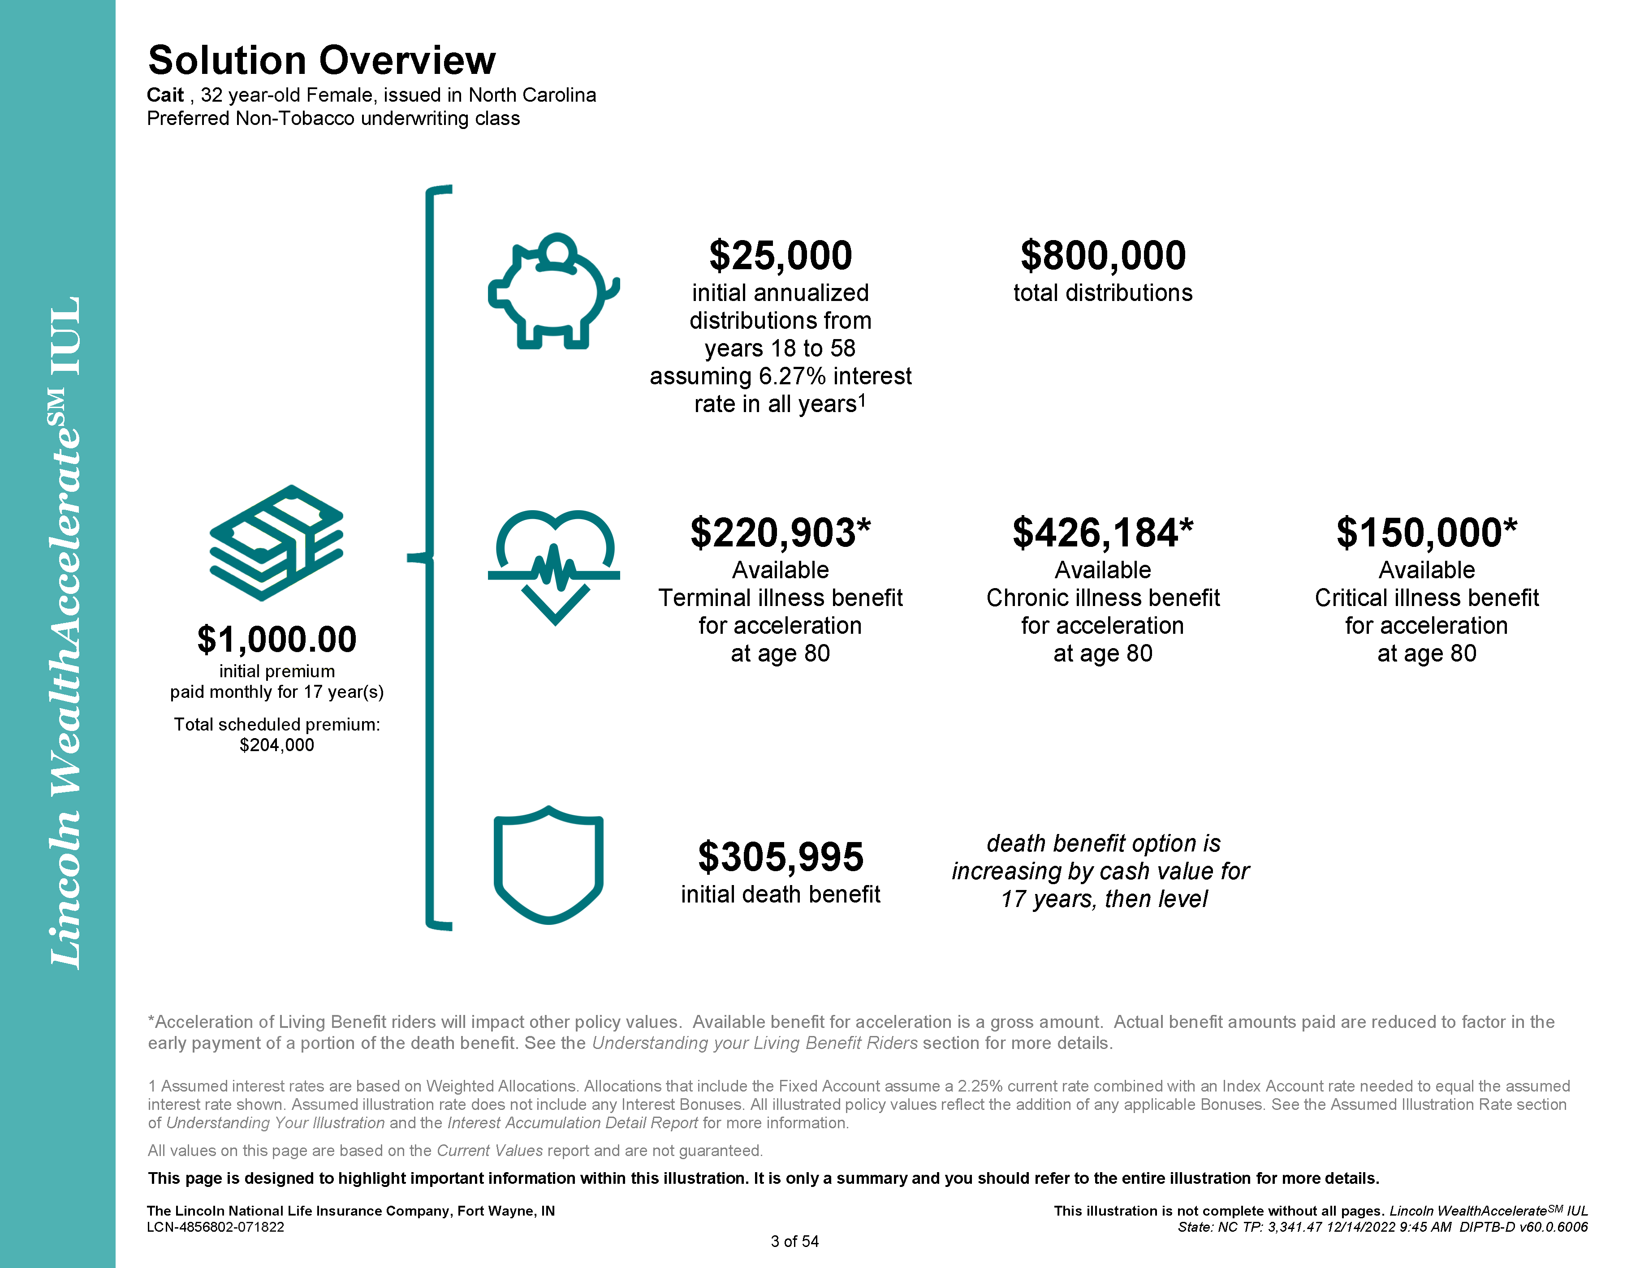
Notes:
WealthAccelerate IUL is designed for protection but also includes the opportunity for cash accumulation and living benefits. This is the solution overview page that is part of the required pages of the client’s illustration.
This page demonstrate what the premium payments are purchasing. As you can see, the $1,000 monthly premiums paid over 17 years (totaling $204,000) purchased and initial death benefit of $305,995, but it also purchased $800,000 in potential distributions over her lifetime. She would be able to use those values for anything she wants, including college tuition, home improvement and supplemental retirement income.
And, if Cait never needs to take supplemental retirement income, she has access to those values in the event of a critical, chronic or terminal illness event. The best thing is she can add these benefits at no up-front cost and will only incur charges if she exercises any of these benefits.

Slide 14
See how Lincoln helps simplify the SALE
Simple
Accessible
Life Insurance Protection
Experience
Simplified process from application to inforce services with a streamlined product that gives your client access to all the advantages of indexed universal life
Accessibility to the policy's cash value and a customer portal that allows your client to access their policy information when it's convenient to them
Permanent life insurance protection through a death benefit and optional riders for critical illness and long-term care
Experience with an industry expert and trusted brand
For financial professional training use only. Not for use with the public.
©2023 Lincoln National Corporation
LCN-5361316-122022
Notes:
Partner with Lincoln to simplify the sale.
It’s SIMPLE because WealthAccelerate offers a simplified process from application to in-force servicing with a STREAMLINED product design.
It’s ACCESSIBLE. Clients have access to policy cash values as well as access to a client-friendly web portal to see policy details.
WealthAccelerate provides Life Insurance PROTECTION and living benefits, through a death benefit as well as optional riders
And just as important EXPERIENCE. Lincoln has been providing clients with protection and financial solutions for over 115 years.

Slide 15
To learn more, visit LFG.com/WealthAccelerate
For financial professional training use only. Not for use with the public.
©2023 Lincoln National Corporation
LCN-5361316-122022
Notes:
<MAY HIDE SLIDE DEPENDING ON AUDIENCE>
For more information or if you’d like access to Lincoln’s client approved marketing materials, please access lfg.com/wealthaccelerate

Slide 16
Lincoln WealthAccelerateSM IUL
Scan to take a faster route from planning to policy.
For financial professional training use only. Not for use with the public.
©2023 Lincoln National Corporation
LCN-5361316-122022
Notes:
<MAY HIDE SLIDE DEPENDING ON AUDIENCE>
Scan this QR code to take a faster route from planning to policy.

Slide 17
Important information
Issuers: The Lincoln National Life Insurance Company, Fort Wayne, IN The Lincoln National Life Insurance Company does not solicit business in the state of New York, nor is it authorized to do so.
All guarantees and benefits of the insurance policy are subject to the claims-paying ability of the issuing insurance company. They are not backed by the broker-dealer and/or insurance agency selling the policy, or any affiliates of those entities other than the issuing company affiliates, and none makes any representations or guarantees regarding the claims-paying ability of the issuer.
In some states, contract terms are set out and coverage may be provided in the form of certificates issued under a group policy issued by The Lincoln National Life Insurance Company to a group life insurance trust. Products, riders and features are subject to state availability. The insurance policy and riders have limitations, exclusions, and/or reductions. Check state availability.
Distributor: Lincoln Financial Distributors, Inc., a broker-dealer
Policy: Lincoln WealthAccelerate® IUL policy form ICC22-UL6093/22-UL6093 and state variations.
Lincoln Financial Group® affiliates, their distributors, and their respective employees, representatives and/or insurance agents do not provide tax, accounting or legal advice. Please consult an independent advisor as to any tax, accounting or legal statements made herein.
The S&P 500 Index is a product of S&P Dow Jones Indices LLC, a division of S&P Global, or its affiliates (“SPDJI”), and has been licensed for use by The Lincoln National Life Insurance Company and Lincoln Life & Annuity Company of New York. Standard & Poor’s® and S&P® are registered trademarks of Dow Jones Trademark Holing LLN (“Dow Jones”); and these trademarks have been licensed for use by SPDJI and sublicensed for certain purposes by The Lincoln National Life Insurance Company and Lincoln Life & Annuity Company of New York. The products are not sponsored, endorsed, sold or promoted by SPDJI, Dow Jones, S&P, their respective affiliates, and none of such parities make any representation regarding the advisability of investing in such products not do they have any liability for any errors, omissions, or interruptions of the S&P 500 Index.
The Fidelity AIM® Dividend Index (the “Index”) is a product of Fidelity Product Services LLC (“FPS”) and has been licensed for use by The Lincoln National Life Insurance Company and its affiliates and reinsurers (“Lincoln”). Fidelity is a registered trademark of FMR LLC. The Index is the exclusive property of FPS and is made and compiled without regard to the needs, including, but not limited to, the suitability needs of Lincoln or any Lincoln life insurance owner. Lincoln exercises sole discretion in determining whether and how the life insurance will be linked to the value of the Index. FPS does not provide investment advice to owners of the life insurance and is no event shall any Lincoln life insurance policy owner be deemed to be a client of FPS. Neither FPS not any third party involved in, or related to, making or compiling the Index (including the Index calculation agent, as applicable). FPS disclaims all warranties, express or implied, including all warranties of merchantability or fitness for a particular use; does not guarantee the adequacy, accuracy, timelines, and/or completeness of the Index or any data or communication related thereto; and assumes no liability for errors, omissions, or interruptions of the Fidelity AIMSM Dividend Index.
For financial professional training use only. Not for use with the public.
©2023 Lincoln National Corporation
LCN-5361316-122022

