Slide 1
Insight on Improving Life Insurance Sales Protection and flexibility your clients never knew they always wanted
Policies issued by American General Life Insurance Company (AGL), Houston, TX, and The United States Life Insurance Company in the City of New York (US Life), members of American International Group, Inc. (AIG)
FOR FINANCIAL PROFESSIONAL USE ONLY – NOT FOR PUBLIC DISTRIBUTION
Notes:
Read slide

Slide 2
Every client will experience at least 1 of 3 things:
Live too long
Die too soon
Get sick along the way
Notes:
Read directly from slide

Slide 3
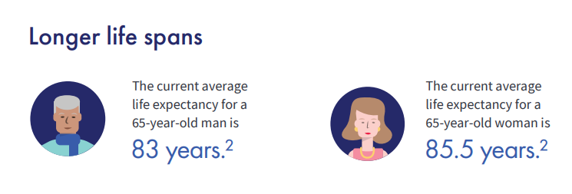
Many clients live longer than expected
1
2
1
¹National Center for Health Statistics, Centers for Disease Control, Health, United States, 2020
²HealthView Services. 2019 Retirement Healthcare Costs Brief. December 2019.
Notes:
Read slide

Slide 4
Can client leave a legacy if they live too long?
Will they use up all their retirement resources with their long life?
What if loved ones live longer than expected too?
Will anything be left as a legacy to spouse or children?
Notes:
Read slide

Slide 5
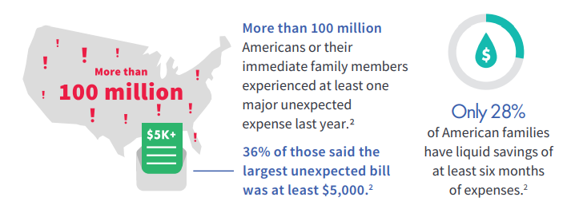
Take care of loved ones in the event of early passing
1
2
3
3
National Center for Health Statistics, Centers for Disease Control, Health, United States, 2020
State of Credit 2021, Experian, September 2021
Trends in College Pricing 2020-2021, The College Board, October 2020
¹Bankrate; Survey; Most Americans wouldn’t cover $1k emergency with savings; January 2019; Page 2
²The Women's Institute for Financial Education; Why Women Need Retirement Planning More Than Men Do; February 13, 2020
³Federal Reserve System; Money in the bank? Assessing families' liquid savings using survey of consumer finances; November 2019
Notes:
Read slide

Slide 6
If client dies too soon, what is financial burden on loved ones?
Will they be able to maintain their lifestyle. Can they still . . .
Take family vacations?
Pay for college?
Pay the mortgage?
Pay unexpected expenses?
Notes:
Read slide

Slide 7
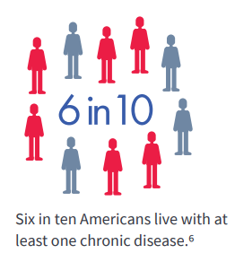
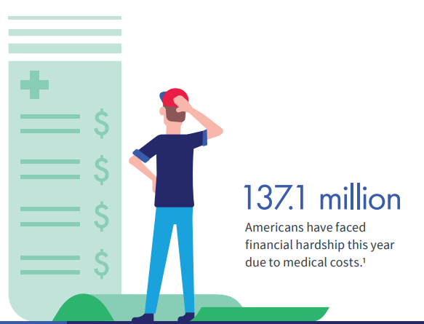
Some get sick along the way . . .
4
2
3
1
2
¹CDC National Center for Chronic Disease Prevention and Health Promotion. January 2020
²Alzheimer's Association. 2019 Alzheimer's Disease Facts and Figures. January 2019
³Journal of Internal Medicine, Prevalence and Correlates of Medical Financial Hardship in the USA; May 2019
⁴Elder Law Answers. Medicare's Limited Nursing Home Coverage. December 2019
Notes:
Read slide

Slide 8
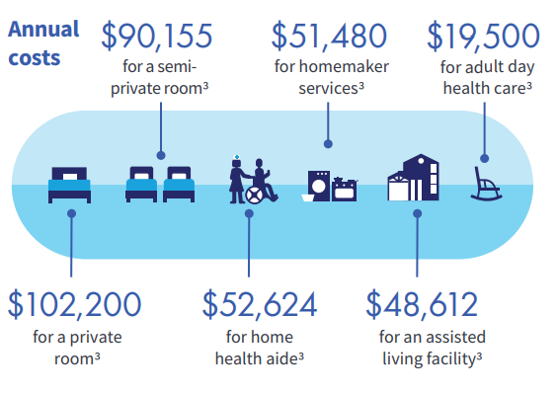
Can your client afford long-term care?
70% of Americans reaching 65 will need some type of long-term care services in their lifetime.
Women typically need care for 3.7 years¹
Men typically need care for 2.2 years²
2
2
2
2
2
2
¹Morningstar. 100 Must-Know Statistics About Long Term Care. December 2020
²Genworth. Cost of Care Survey 2019. Conducted by CareScout. November 2019
Notes:
Read slide

Slide 9
How will client pay for unexpected healthcare expenses?
Will client drain savings and/or retirement assets?
Will this affect the financial stability of loved ones?
Can client and their family maintain their lifestyle?
Notes:
Read slide

Slide 10
The right permanent life insurance can help
Notes:
Read directly from slide

Slide 11
Prepare for all 3 with flexible, low-cost life insurance
Live too long: protect your legacy
Protect policy from adverse market performance with strong cash value
Customize policy to fit various needs for longer lifetimes with flexible premium payment structures
Ensure legacy for loved ones
Notes:
Read slide

Slide 12
Prepare for all 3 with flexible, low-cost life insurance
Die too soon: protect loved ones from financial burden
Guaranteed death benefit beyond life expectancy
Flexibility when needs change - reimburse premiums paid if needs changed, and no longer need death benefit or chronic illness protection with Return of Premium option
Notes:
Read slide

Slide 13
Prepare for all 3 with flexible, low-cost life insurance
Get sick along the way: Protect yourself from unforeseen illness expenses
Access funds for qualifying chronic illness with Accelerated Access Solution
No receipts needed with Chronic illness rider (indemnity benefit)
Full waiver of monthly deductions while on claim
Flexible benefit based monthly benefit options
No long-term care or health certification required to sell*
*Some states may have state-specific requirements
Notes:
Read slide

Slide 14
New Value+ Protector III offers Optionality with . . .
Low-cost premiums fits into client’s budget - Value+ Protector III premium lower than prior version
Improved target premiums in key cells
Preferred classes ages 45-65
Average increase of 5%
NEW Enhanced Surrender Value Rider (ROP)
Automatically included, no additional cost
100% ROP at end of policy year 25¹
50% ROP at end of policy year 20
Up to 40% of death benefit
Enactment requires full surrender. Enhanced Surrender Value is paid in lieu of policy's cash surrender value
NEW Franklin Quality Dividend Index
¹Surrender age 40 and younger: 75% ROP, capped at 30% of face amount
Notes:
Read slide

Slide 15
Value+ Protector III – Full Pay
Company | Product | Premium | Guar to Age | CSV YR20 | Carry to Age | Target | ROP
American General | Value+ Protector III IUL (MLSB) | $7,733 | 88 | $176,973 | 121 | $11,352 | Yes
John Hancock | Protection IUL 22 (Barclays Global MA Bonus Rate) | $7,754 | 79 | $131,075 | 121 | $10,700
Protective | Indexed Choice UL 7-21 | $8,225 | 89 | $200,080 | 121 | $10,010
Mutual of Omaha | Life Protection Advantage IUL | $8,252 | 90 | $193,775 | 120 | $9,180 | Yes
Lincoln Financial | WealthPreserve 2 IUL (2020) (Fidelity AIM Dividend) | $8,517 | 90 | $203,281 | 126 | $11,240
Nationwide | Indexed UL Protector II 2020 | $8,655 | 70 | $203,874 | 120 | $9,910
Symetra | Symetra Protector IUL 3.0 | $8,813 | 91 | $216,505 | 120 | $11,534
North American | Protection Builder IUL (Fidelity Multifactor Yield Index 5% ER) | $9,043 | 76 | $208,735 | 112 | $10,740 | Yes
Prudential | PruLife Founders Plus UL (2021) (Goldman Sachs) | $9,148 | 90 | $189,745 | 121 | $11,740
50/M/PPNT, $1M DB, Full pay at Max% Rate. Rates as of 6/13/2022.
Carriers mentioned in the presentation are peer group competitors of AGL. Every attempt has been made to verify the accuracy of competitor information.
Notes:
Read slide

Slide 16
Value+ Protector III – Ten Pay
Company | Product | Illustrative Rate | Premium | Guar to Age | CSV YR20 | Carry to Age | Target | ROP
John Hancock | Protection IUL 22 (Barclays Global MA Bonus Rate) | 6.34% | $14,489 | 75 | $185,697 | 121 | $10,700
American General | Value+ Protector III IUL (MLSB) | 5.99% | $15,475 | 82 | $262,292 | 121 | $11,352 | Yes
North American | Protection Builder IUL (Fidelity Multifactor Yield Index 5% ER) | 6.16% | $17,758 | 74 | $308,459 | 121 | $10,740 | Yes
Lincoln Financial | WealthPreserve 2 IUL (2020) (Fidelity AIM Dividend Indexed Account) | 5.74% | $17,764 | 71 | $293,151 | 121 | $11,240
Mutual of Omaha | Life Protection Advantage IUL | 5.48% | $18,060 | 77 | $302,373 | 121 | $9,180 | Yes
Symetra | Symetra Protector IUL 3.0 | 5.61% | $18,563 | 88 | $320,985 | 121 | $11,534
John Hancock | Protection IUL 22 | 5.48% | $18,775 | 78 | $220,435 | 121 | $10,700
Protective | Indexed Choice UL 7-21 | 5.21% | $18,788 | 83 | $311,570 | 121 | $10,010
Nationwide | Indexed UL Protector II 2020 | 5.74% | $19,274 | 70 | $336,702 | 121 | $9,910
Prudential | PruLife Founders Plus UL (2021) (Goldman Sachs Voyager Indexed Account) | 4.94% | $20,632 | 90 | $305,634 | 121 | $11,740
50/M/PPNT, $1M DB, Ten pay at Max% Rate. Rates as of 6/13/2022.
Carriers mentioned in the presentation are peer group competitors of AGL. Every attempt has been made to verify the accuracy of competitor information.
Notes:
Read slide

Slide 17
What happens if index performance is lower?
Index performance varies each year
Important to set expectation with client that actual index performance may vary from illustrated performance
Need to ensure product can sustain itself when stress testing
How does it look if index performs 1% lower than max rate every policy year?
Carriers mentioned in the presentation are peer group competitors of AGL. Every attempt has been made to verify the accuracy of competitor information.
Notes:
Read slide

Slide 18
Value+ Protector III – Full Pay
Assumes same premium from prior example – using illustration rate 1% lower than each carrier's max rate
Company | Product | Premium | Guar to Age | CSV YR20 | Carry to Age | Target | ROP
American General | Value+ Protector III IUL (MLSB) | $7,733 | 88 | $158,762 | 96 | $11,352 | Yes
John Hancock | Protection IUL 22 (Barclays Global MA Bonus Rate) | $7,754 | 79 | $115,587 | 89 | $10,700
Protective | Indexed Choice UL 7-21 | $8,225 | 90 | $178,012 | 96 | $10,010
Mutual of Omaha | Life Protection Advantage IUL | $8,252 | 79 | $171,877 | 99 | $9,180 | Yes
Lincoln Financial | WealthPreserve 2 IUL (2020) (Fidelity AIM Dividend) | $8,517 | 89 | $180,351 | 94 | $11,240
Nationwide | Indexed UL Protector II 2020 | $8,655 | 90 | $180,219 | 95 | $9,910
Symetra | Symetra Protector IUL 3.0 | $8,813 | 90 | $193,078 | 96 | $11,534
North American | Protection Builder IUL (Fidelity Multifactor Yield Index 5% ER) | $9,043 | 70 | $183,801 | 94 | $10,740 | Yes
Prudential | PruLife Founders Plus UL (2021) (Goldman Sachs) | $9,148 | 91 | $170,111 | 97 | $11,740
50/M/PPNT, $1M DB, Full pay at Max% Rate minus 1%. Rates as of 6/13/2022.
Carriers mentioned in the presentation are peer group competitors of AGL. Every attempt has been made to verify the accuracy of competitor information.
Notes:
Read slide

Slide 19
Value+ Protector III – Ten Pay
Assumes same premium from prior example – using illustration rate 1% lower than each carrier's max rate
Company | Product | Illustrative Rate | Premium | Guar to Age | CSV YR20 | Carry to Age | Target | ROP
John Hancock | Protection IUL 22 (Barclays Global MA Bonus Rate) | 5.34% | $14,489 | 75 | $155,744 | 88 | $10,700
American General | Value+ Protector III IUL (MLSB) | 4.99% | $15,475 | 82 | $223,445 | 94 | $11,352 | Yes
50/M/PPNT, $1M DB, Ten pay at Max% Rate minus 1%. Rates as of 6/13/2022.
Carriers mentioned in the presentation are peer group competitors of AGL. Every attempt has been made to verify the accuracy of competitor information.
Notes:
Read slide

Slide 20
Still protecting what matters most when stress tested:
Guaranteed death benefit beyond life expectancy for full pay, close to life expectancy for 10 pay
Strong cash value helps death benefit carry into 90s
Return of Premium (Enhanced Surrender Value Rider) still available
Value Plus Protector III – competitive premium & strong performance even when stress tested!
Notes:
Read slide

Slide 21
Preparing for unexpected illness
Notes:
Read directly from slide

Slide 22
Accelerated Access Solution – Rider details
Paid chronic illness rider
Unable to perform 2 out of 6 Activities of Daily living¹, or Severe Cognitive Impairment
100% death benefit acceleration, up to $3 million
Dollar-for-dollar acceleration
Condition does NOT have to be permanent
Indemnity benefit
No receipts – spend benefit on anything
NOT reimbursement – once certified, acceleration is provided regardless of actual costs of care incurred
FULL waiver of monthly deductions
No A&H license or LTC certification required*
¹Activities of daily living include; bathing, eating, dressing, continence, toileting, transferring
*IRS caps the maximum per diem limitation excludable from taxable income each year. The 2022 maximum is $390/day or $11,863/month. Subsequent years may be higher.
**Some states may have state-specific requirements
Notes:
Read slide

Slide 23
Value+ Protector III – With AAS/LTC Rider
Company | Product | Premium | Guar to Age | CSV YR20 | Carry to Age | Target | ROP | CI/LTC Indemnity
John Hancock | Protection IUL 22 (Barclays Global MA Bonus Rate) w Long-Term Care Rider | $8,410 | 79 | $130,155 | 121 | $11,357
American General | Value+ Protector III IUL (MLSB) with AAS | $8,885 | 88 | $173,553 | 121 | $12,612 | Yes | Yes
Protective | Indexed Choice UL 7-21 w ExtendCare | $9,002 | 88 | $222,349 | 121 | $11,011 |  | Yes
Mutual of Omaha | Life Protection Advantage IUL w Long Term Care Rider | $9,226 | 90 | $190,607 | 120 | $10,100 | Yes
Lincoln Financial | WealthPreserve 2 IUL (2020) (Fidelity AIM Dividend Indexed Account) w Care Coverage ABR | $9,300 | 90 | $217,445 | 99 | $11,490
Symetra | Symetra Protector IUL 3.0 w Chronic Illness Plus Rider | $9,679 | 91 | $225,561 | 120 | $11,995 |  | Yes
Nationwide | Indexed UL Protector II 2020 w Long Term Care Rider II | $9,699 | 70 | $203,455 | 120 | $10,906 |  | Yes
Prudential | PruLife Founders Plus UL (2021) (Goldman Sachs Voyager Indexed Account) w BenefitAccess Rider | $9,883 | 88 | $208,606 | 121 | $12,830 |  | Yes
50/M/PPNT, $1M DB, Full pay at Max% Rate. AAS/LTC Rider 2% benefit. Rates as of 6/13/2022.
Carriers mentioned in the presentation are peer group competitors of AGL. Every attempt has been made to verify the accuracy of competitor information.
Notes:
Read slide

Slide 24
Value+ Protector III
can help meet clients needs,
no matter whether they
live too long
die too soon
or get sick along the way
Notes:
Read directly from slide

Slide 25
Flexible, low-cost life insurance: Value+ Protector III
Protect loved ones from financial burden
Competitive premiums and guaranteed death benefit beyond life expectancy
Protect policy from adverse market performance
Strong cash value designed to support policy’s death benefit – even when stress tested
Protect from unforeseen illness expenses
Chronic illness rider available to accelerate death benefit chronic illness needs
Indemnity benefit – no receipts needed
Provide clients flexibility - Optionality
Return of Premium feature available to reimburse premiums paid in event needs have changed, and no longer need death benefit or chronic illness protection
Flexible protection your clients never knew they always wanted, no matter whether they live too long, die too soon, or get sick along the way
Notes:
Read slide

Slide 26
Policies issued by American General Life Insurance Company (AGL), Houston, TX. Policy Form Numbers: ICC16-16760, 16760; Rider Form Numbers: 15600, ICC15-15600, 13600-5, ICC18-18012, 18012, ICC16-16420, 16420, ICC13-13601, 13601, 07620, ICC14-14002, 14002, ICC15-15992, 15992, 15997, ICC18-18004, 18004, ICC15-15990, 15990. Issuing company AGL is responsible for financial obligations of insurance products and is a member of American International Group, Inc. (AIG). Guarantees are backed by the claims-paying ability of the issuing insurance company. AGL does not solicit, issue or deliver policies or contracts in the state of New York. Products may not be available in all states and product features may vary by state.
This material is general in nature, was developed for educational use only, and is not intended to provide financial, legal, fiduciary, accounting or tax advice, nor is it intended to make any recommendations. Applicable laws and regulations are complex and subject to change. For legal, accounting or tax advice consult the appropriate professional.
The equity index account provides benefits linked to an external equity index and does not participate directly in the equity index market. While index interest credited to the policy is related to the performance of the underlying index, it is not an investment in that index. The actual amount of index interest credited to an index universal life insurance policy will vary based on the performance of the index, the interest rate environment, the cost of options, and other economic factors.
Information about the ML Strategic Balanced Index®
The ML Strategic Balanced Index® provides systematic, rules-based access to the blended performance of two underlying indices—the S&P 500 (without dividends), which serves to represent equity performance, and the Merrill Lynch 10-year U.S. Treasury Futures Total Return Index, which serves to represent fixed income performance. To help manage overall return volatility, the Index may also systematically utilize cash performance in addition to the performance of the two underlying indices.
Important Note: The ML Strategic Balanced Index® embeds an annual index cost in the calculations of the change in Index Value over the Index Term. This “embedded index cost” will reduce any change in Index Value over the Index Term that would otherwise have been used in the calculation of index interest, and it funds certain operational and licensing costs for the index. It is not a fee paid by you or received by the Company. The Company’s licensing relationship with Merrill Lynch, Pierce, Fenner & Smith Incorporated for use of the ML Strategic Balanced Index and for use of certain service marks includes the Company’s purchase of financial instruments for purposes of meeting its interest crediting obligations. Some portion of those instruments will, or may be, purchased from Merrill Lynch, Pierce, Fenner & Smith Incorporated or its Affiliates.
Merrill Lynch, Pierce, Fenner & Smith Incorporated and its affiliates (“BofA Merrill Lynch”) indices and related information, the name “BofA Merrill Lynch”, and related trademarks, are intellectual property licensed from BofA Merrill Lynch, and may not be copied, used, or distributed without BofA Merrill Lynch’s prior written approval. The products of licensee American General Life Insurance Company have not been passed on as to their legality or suitability, and are not regulated, issued, endorsed, sold, guaranteed, or promoted by BofA Merrill Lynch.
BOFA MERRILL LYNCH MAKES NO WARRANTIES AND BEARS NO LIABILITY WITH RESPECT TO ANY INDEX, ANY RELATED INFORMATION, ITS TRADEMARKS, OR THE PRODUCT(S) (INCLUDING WITHOUT LIMITATION, ITS QUALITY, ACCURACY,SUITABILITY AND/OR COMPLETENESS).
The ML Strategic Balanced Index (the “Index”) is the property of Merrill Lynch, Pierce, Fenner & Smith Incorporated, which has contracted with S&P Opco, LLC (a subsidiary of S&P Dow Jones Indices LLC) to calculate and maintain the Index. The Index is not sponsored by S&P Dow Jones Indices or its affiliates or its third party licensors (collectively, “S&P Dow Jones Indices”). S&P Dow Jones Indices will not be liable for any errors or omissions in calculating the Index. “Calculated by S&P Dow Jones Indices” and the related stylized mark(s) are service marks of S&P Dow Jones Indices and have been licensed for use by Merrill Lynch, Pierce, Fenner & Smith Incorporated. Note that the ML Strategic Balanced Index™ is not available for policies issued in the State of New York
Notes:
Read slide

Slide 27
Information about the S&P 500® Index
The S&P 500 Index is a product of S&P Dow Jones Indices LLC (“SPDJI”), and has been licensed for use by AGL and US Life. Standard & Poor’s ®, S&P® and S&P 500 ® are registered trademarks of Standard & Poor’s Financial Services LLC (“S&P”); Dow Jones® is a registered trademark of Dow Jones Trademark Holdings LLC (“Dow Jones”); and these trademarks have been licensed for use by SPDJI and sublicensed for certain purposes by AGL and US Life. AGL and US Life’s Max Accumulator+ is not sponsored, endorsed, sold or promoted by SPDJI, Dow Jones, S&P, their respective affiliates, and none of such parties make any representation regarding the advisability of investing in such product(s) nor do they have any liability for any errors, omissions, or interruptions of the S&P 500 Index
Information about the PIMCO Global Optima Index
The PIMCO Global Optima IndexTM (the “Index”) is a comprehensive equity and bond index, offering exposure to global equity and U.S. fixed income markets. The Index is a trademark of Pacific Investment Management Company LLC (“PIMCO”) and has been licensed for use for certain purposes by American General Life Insurance Company with select life insurance and annuity products. The Index is the exclusive property of PIMCO and is made and compiled without regard to the needs, including, but not limited to, the suitability or appropriateness needs, as applicable, of the Company, the Product, or owners of the Product. The Product is not sold, sponsored, endorsed or promoted by PIMCO or any other party involved in, or related to, making or compiling the Index. PIMCO does not provide investment advice to the Company with respect to the Product or to owners of the Product.
Neither PIMCO nor any other party involved in, or related to, making or compiling the Index has any obligation to continue to provide the Index to the Company with respect to the Product. Neither PIMCO nor any other party involved in, or related to, making or compiling the Index makes any representation regarding the Index, Index information, performance, annuities generally or the Product particularly.
PIMCO disclaims all warranties, express or implied, including all warranties of merchantability or fitness for a particular purpose or use. PIMCO shall have no responsibility or liability whatsoever with respect to the Product.
The Licensed PIMCO Licensed Index is comprised of a number of constituents, some of which are owned by entities other than PIMCO. The Licensed PIMCO Indices rely on a variety of publicly available data and information and licensable equity and fixed income sub-indices. All disclaimers referenced in the Agreement relative to PIMCO also apply separately to those entities that are owners of the constituents of the Licensed PIMCO Indices. The constituents of the Licensed PIMCO Indices include: MSCI Inc., FTSE International Limited, FTSE TMX Global, Debt Capital Markets, Inc., Frank Russell Company and certain ETFs. The Licensee expressly agrees to include the following disclaimer and limited language in connection with the use of the Licensed PIMCO Indices for the Permitted Purposes.
Notes:
Read slide

Slide 28
Information about the Franklin Quality Dividend IndexTM
The Franklin Quality Dividend (“FQD”) Index has been developed and is owned solely by QS Investors LLC, a subsidiary of Franklin Resources, Inc. Neither Blackrock (the sponsor of iShares ETFs) nor Invesco is affiliated with Franklin Resources, Inc. and QS Investors, LLC. FQD and any security or product based on or making use of FQD are not sponsored, endorsed, or promoted by Blackrock or Invesco, and neither company bears any responsibility or liability for or with respect to FQD or any security or product based on or making use of FQD.
FQD is calculated on behalf of QS Investors, LLC by Solactive or its affiliate, agent or partner. Solactive, QS Investors, LLC, Franklin Resources, Inc. and their respective affiliates do not make any claim, prediction, warranty or representation as to the accuracy and completeness of FQD, the results to be obtained from use of FQDI or the suitability of FQD for the purpose to which it is being put by American General Life Insurance Company, and bear no liability for FQD or for any security or product based on or making use of FQD.
FQD embeds an annual index cost in the calculations of the change in index value. This embedded index cost will reduce any change in index value, and it funds certain operational and licensing costs for the Index. Since it will affect the return of the Index, it may also impact the amount of interest credited to an index annuity; however, it is not a fee paid by the policy owner or received by the issuing insurance company.
Past performance is not indicative of future results.
Carriers mentioned in the presentation are peer group competitors of American General Life. Every attempt has been made to verify the accuracy of competitor information included in this presentation. Product information and rates are subject to change at any time.
AGLC201804 ©2022 AIG. All rights reserved. FOR FINANCIAL PROFESSIONAL USE ONLY-NOT FOR PUBLIC DISTRIBUTION
Notes:
Read slide

Slide 29
An Accelerated Death Benefit Rider (ABR) is not a replacement for Long Term Care Insurance (LTCI). It is a life insurance benefit that gives you the option to accelerate some of the death benefit in the event the insured meets the criteria for a qualifying event described in the policy. The rider does not provide long-term care insurance subject to California insurance law, is not a California Partnership for Long-Term Care program policy. The policy is not a Medicare supplement.
ABRs and LTCI provide different types of benefits. An ABR allows the insured to access a portion of the life insurance policy’s death benefit while living. ABR payments are unrestricted and may be used for any purpose. LTCI provides reimbursement for necessary care received due to the inability to perform activities of daily living or cognitive impairment. LTCI coverage may include reimbursement for the cost of a nursing home, assisted living, home health care, homemaker services, adult day care, hospice services or respite care for the primary caretaker and the benefits may be conditioned on certain requirements or meeting an elimination period or limited by type of service, the number of days or a maximum dollar limit. Some ABRs and all LTCI are conditioned upon the insured not being able to perform two or more of the activities of daily living or being cognitively impaired.
This ABR pays proceeds that are intended to qualify for favorable tax treatment under section 101(g) of the Federal Internal Revenue Code. The federal, state, or local tax consequences resulting from payment of an ABR will depend on the specific facts and circumstances, and consequently advice and guidance should be obtained from a personal tax advisor prior to the receipt of any payments. ABR payments may affect eligibility for, or amounts of, Medicaid or other benefits provided by federal, state, or local government. Death benefits and policy values, such as cash values, premium payments and cost of insurance charges if applicable, will be reduced if an ABR payment is made. ABR payments may be limited by the contract or by outstanding policy loans.
Notes:
Read slide

