Slide 1
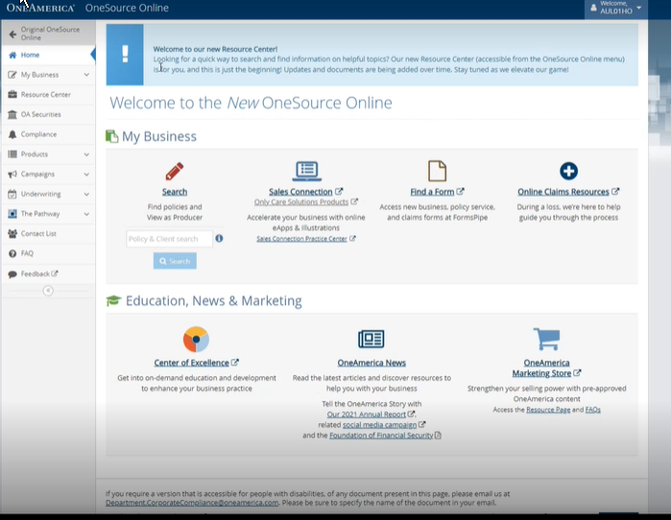
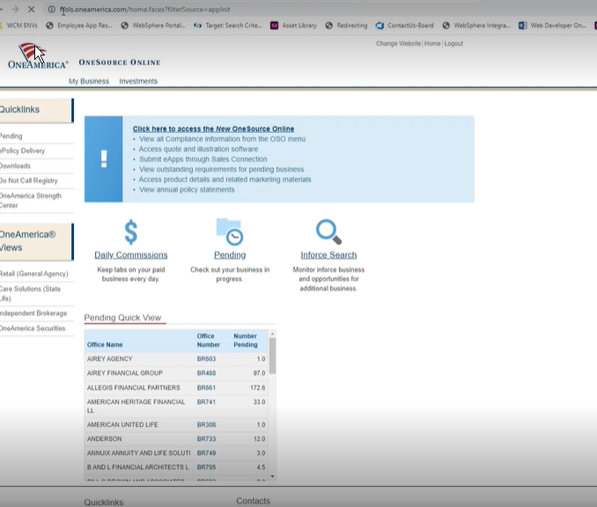
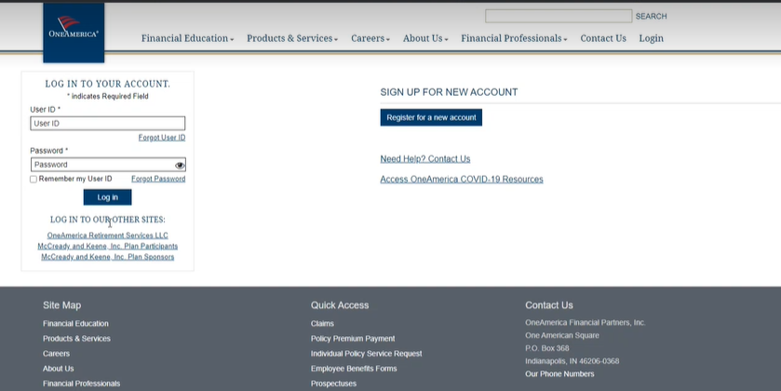
Bookmarked OSO Next will be redirected
Bookmarked OSO Vintage will be redirected
Redirect will place all users on OneAmerica.com.
To continue, login using your existing credentials.

Slide 2
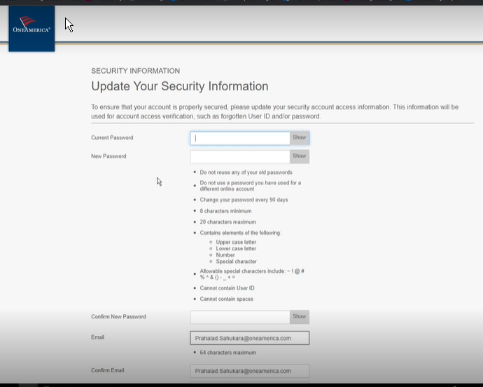
Once logged in, producers will be asked to update their security information. This includes:
Password
Email
Phone
Security question

Slide 3
After successfully updating their information, producers will be logged in to OSO Next. If necessary, producers may go back to Vintage in the top left corner.

