Slide 1
3 Life Insurance Accumulation Concepts
Joe Ross, ChFC, CLU, CRC
Vice President – Sales Productivity & Business Development Life Insurance & Retirement Division
American International Group, Inc.
Policies issued by American General Life Insurance Company (AGL), Houston, TX and by
The United States Life Insurance Company in the state of New York (US Life), members of American International Group, Inc. (AIG)
Notes:
Hello, and welcome to today’s discussion about 3 Life Insurance Accumulation Concepts.
You'll hear about three separate stories that work incredibly well together to create a presentation that helps people recognize additional ways they can use life insurance for financial security.

Slide 2
Important Disclosures
This information is general in nature, was developed for educational use only, and is not intended to provide financial, legal, fiduciary, accounting or tax advice, nor is it intended to make any recommendations. Applicable laws and regulations are complex and subject to change. Please consult with your financial professional regarding your situation. For legal, accounting or tax advice consult the appropriate professional.
Policies issued by American General Life Insurance Company (AGL), Houston, TX except in New York, where issued by The United States Life Insurance Company in the City of New York (US Life). Policy form number ICC19-19646, 19646, 19646N Rev0120. Issuing companies AGL and US Life are responsible for financial obligations of insurance products and are members of American International Group, Inc. (AIG). AGL does not solicit, issue or deliver policies in the state of New York. Guarantees are backed by the claims-paying ability of the issuing insurance company. Products may not be available in all states and product features may vary by state.
AGLC200423REV0921 Red Oak: 1823862
Notes:
Before we get started, here are some important notes and disclosures about today’s presentation. Please be sure to familiarize yourself with these important disclosures.

Slide 3
The Rule Of 25
The $5 - $10 - $20 Story
How Much Does
Life Insurance Cost?
Notes:
I have three stories on our agenda for today.
The first one is a story I like to call “The Rule Of 25.” You’ll understand why in a minute. This rule helps people see if they’re on-track to save enough for their retirement goals. It’s not an in-depth analysis, but it’s a good rule-of-thumb you can use when you don’t have your computer and a comprehensive financial planning software program in front of you. Interestingly, many people come to realize that they’re not saving enough, and they need to save more.
The second story --- “The $5 - $10 - $20 Story” --- shows them how the tax advantages of life insurance may make life insurance an attractive way to accumulate supplemental retirement savings.
And lastly, many people have been led to believe that life insurance is too expensive to use as a tool for accumulating supplemental retirement savings. That’s where this third story --- “How Much Does Life Insurance Cost?” --- comes into play. This simple story shows you how cost-effective life insurance can be for accumulating supplemental retirement savings.
When you put all three of these stories together, you have a rather compelling argument for the benefits of life insurance that extend beyond just the death benefit… that life insurance can also be attractive for accumulating supplemental savings.
The first story is called “The Rule Of 25.”
Let’s see how that works.

Slide 4
Start With "The 4% Rule"
In 1994 William Bengen penned the research work that established “The 4% Rule”
“Determining Withdrawal Rates Using Historical Data”, October 1994, Journal For Financial Planning (p.171)
It’s a great rule for retirees that want to know how much they can withdraw
In your first year of retirement, multiply your portfolio by 4%
$1,000,000 x 4% = $40,000 in the first year
Annually increase withdrawals for cost-of-living, regardless of portfolio performance
Bengen’s research suggests a 90% chance of 30-year success
Notes:
You might all know of something that – in financial circles – we refer to as “The 4% Rule.”
What is it and where did it come from?
There was a landmark article published in 1994 by William Bengen.
His research used hundreds of different market scenarios and a process we call “Monte Carlo Simulation.”
From that article came what’s known as “The 4% Rule.”
Bengen’s basic conclusion is that, if you withdraw 4% from your investment portfolio in the first year of retirement, and increase those withdrawals each year for inflation, that you’d have a statistical 90% chance of still having money in your portfolio after 30 years. That’s because 90% of the scenarios he modeled still had money remaining after 30 years.
This approach would take a typical investor from age 65 to age 95, which would satisfy most investors.

Slide 5
"The Rule Of 25"
The Rule Of 25 is The 4% Rule in reverse!
It’s a great rule-of-thumb for PRE-retirees
How many times does 4% go into 100%?
3 simple steps:
Estimate your expenses in your first year of retirement (assume it’s $60,000)
Subtract known sources of retirement income (assume S.S. = $20,000)
Multiply your “net” expenses by 25 ($40,000 x 25 = $1,000,000)
$1,000,000 x 4% = $40,000
$40,000 x 25 = $1,000,000
Now PRE-retirees know what they should be targeting as retirement savings
Notes:
So what’s “The Rule of 25”???
It’s just The 4% Rule in reverse.
Whereas The 4% Rule is a pretty good rule-of-thumb for investors that are retiring, The 4% Rule is not very helpful to pre-retirees.
That’s where The Rule of 25 comes in… it’s very helpful to pre-retirees.
The Rule Of 25 turns The 4% Rule backwards in three easy steps:
Estimate your living expenses in your first year of retirement. In this example, let’s assume that’s $60,000.
Next, subtract your knowns sources of retirement income. Although this could include pension income, for most people in the future that’ll be Social Security income. Let’s assume you expect to receive $20,000 annually from Social Security.
Now multiply your $40,000 “net” expenses by 25. The answer is $1,000,000.
So you can see that $1 million x 4% = $40,000.
In the reverse, you can see that $40,000 x 25 = $1 million.
Now pre-retiree investors know what they should be targeting as their retirement savings.

Slide 6
The $5 - $10 - $20 Story
Notes:
Now that we’ve helped your clients and prospects get an idea about whether they’re on-track… or not on-track… to achieve their retirement savings goals, let’s talk about a simple story that can help people understand how they might be able to use life insurance to bridge the gap.
This second story is a story I like to call “The $5 - $10 - $20 Story”
Let’s see how it works.

Slide 7
The $5 - $10 - $20 Story
If you had an investment that had this potential:
you contribute a total of $5…
over time the investment could grow to $10, and…
during your retirement you could take out a total of $20…
Would you do it?
Notice that the $5 doubled to $10…
And the $10 doubled to $20
This hypothetical example is for illustrative purposes only.
Notes:
Let me begin again by asking you a question:
If you had an investment that had this potential:
You contributed a total of $5
Over time the investment could grow to $10, and
During your retirement you could take out a total of $20…
Would you do it???
Notice that the $5 doubled to $10,
And the $10 doubled to $20.
And notice that the $5 quadrupled to $20.
Most people I talk to think that would be a pretty good deal.

Slide 8
The $5 - $10 - $20 Story
If you had to pay tax on
one of those numbers:
The $5 you put in…
The $10 it grew to…
OR
The $20 you took out…
Which would you choose?
This hypothetical example is for illustrative purposes only.
Notes:
So let’s assume what you just saw could happen…
You put in $5
It grew to $10
You took out $20
But let’s further assume you had to pay TAX on one of those three numbers.
Which one would you choose to pay taxes on?
In my experience this rarely fails… people say they would pay tax on the $5.
Well let’s see if we can make these numbers come to life!

Slide 9
The $5 - $10 - $20 Story
AIG’s Max Accumulator+ II IUL
Male, age 40, PNT
$1,000 Monthly Premium to A70 = $360,000
Age 70 projected value @ 5.00% = $748,000
Projected loans* ages 71 – 95 (25 yrs) = $1,469,000
($58,766 x 25)
Which would you choose to pay tax on?
This is a hypothetical example is for illustrative purposes only. Values as of 8/27/21. AG49-A Compliant.
* Based on current federal income tax law. Assumes the use of withdrawals to basis and/or policy loans. If the policy is classified as a modified endowment contract (see IRC section 7702A), withdrawals or loans are subject to regular income tax and an additional 10% tax penalty may apply if taken prior to age 59 ½.
Death Benefits are generally excludable from the beneficiary’s federal taxable income under most circumstances and under current federal income tax law.
Notes:
(The values on this page were calculated on 8/27/2021 using updated calculations that reflect changes due to the updates made to IRC Section 7702.)
So let’s look at an illustration to get an idea of how life insurance might project.
In this example I’ll illustrate Max Accumulator+ for a male, age 40 in the preferred non-tobacco underwriting class.
We’ll contribute premiums of $1,000 monthly to age 70… that’s a total of $360,000 of premiums
When I look at the illustration at age 70, it shows a projected value, assuming a 5.00% projected interest rate (which is less than the current maximum illustrated rate) of just over $748,000.
I ran this illustration by solving for the annual loans that could be taken from age 71 to age 95 (that’s 25 years of distributions). The illustration solved for $58,766 per year. When you multiply that by 25 years, it’s total loans of just over $1,469,000.
(Assumes the use of withdrawals to basis and/or policy loans. If the policy is classified as a modified endowment contract (see IRC section 7702A), withdrawals or loans are subject to regular income tax and an additional 10% tax penalty may apply if taken prior to age 59 ½.)
Notice the similarity to our $5 - $10 - $20 example.
In this hypothetical scenario the $360,000 of premiums more than doubled to the age 70 projected value of $748,000; and the $748,000 projected age-70 value nearly doubled to the $1,469,000 of projected policy loans.
You might be glad to know that, if this hypothetical scenario played out this way in real life, you would’ve paid tax on the $360,000 of premiums, not on the growth, and not on the $1,469,000 of loans taken from the policy.

Slide 10
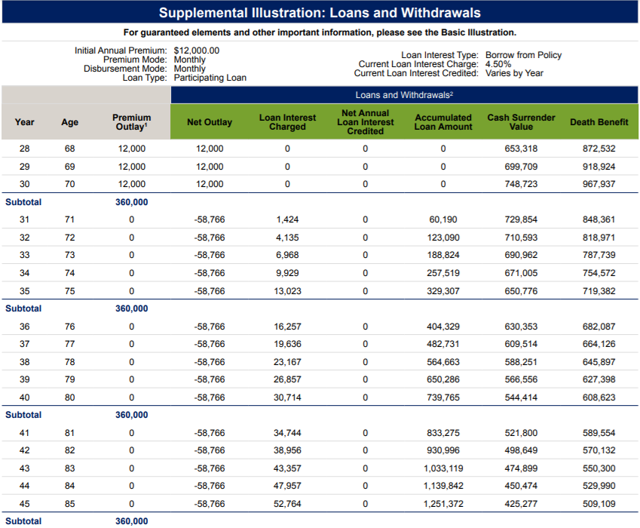
Policy is illustrated as a non-Modified Endowment Contract (non-MEC)
Not an actual case. For illustrative purposes only.
Max Accumulator+ II IUL Values as of 7/27/2021
10
Notes:
Here’s a screen capture of a part of the illustration from age 68 through ag 85 showing:
The last 3 premiums of $1,000-per-month, totaling $12,000-per-year, for a grand total of $360,000;
The projected age-70 value of $748,723; and
Values as of August 27, 2021

Slide 11
Total Projected Loans:
$58,766
x 25 years
$1,469,000
Policy is illustrated as a non-Modified Endowment Contract (non-MEC)
Not an actual case. For illustrative purposes only.
Max Accumulator+ II IUL Values as of 7/27/2021
Notes:
The projected loans of $58,766-per-year that continued for 25 years, totaling just over $1,469,000.
Values as of August 27, 2021

Slide 12
How Much Does
Life Insurance Cost?
Notes:
Now that we know a simple formula for determining how much money to consider paying into a life insurance policy for supplemental retirement accumulations, some people will ask “How much does one of those life insurance policies cost?”
Financial Advisors and investors generally know that every investment has a cost… taxes, commissions, asset management fees, etc.
These costs can be clearly documented in a prospectus for many investments.
Most of these costs are percentages that remain constant within the investment, so they’re easy to understand.
For example, you might invest in a mutual fund that has a 1% asset management fee. If that mutual fund grew by 10%, you’d net 9% after paying the 1% asset management fee.
But with life insurance it’s not nearly so clear. Many of the costs of a life insurance policy change over time, making it difficult to pin-down the exact cost, and even more difficult to express in terms that investors and financial advisors can easily relate to, and can easily connect to the cost of other alternatives.
As a result, many Advisors ask “But how much does a maximum-funded Life Insurance Policy actually cost?”
I’ve seen many life insurance specialists struggle with the answer to this question.
Today I’m going to put that answer into terms that Financial Advisors (and most investors) can more easily understand.

Slide 13
How Much Does Life Insurance Cost?
Sample Assumptions:
Male 40 PNT
Product: AIG Max Accumulator+ II IUL
Projected interest rate: 5.00% (.65% bonus yrs. 6+)
Premiums: $1,000 per month to age 70
Initial DB: $220,000 (non-medical!)
Participating loans for 25 years* (age 71 – 95): $58,766
This is a hypothetical example is for illustrative purposes only. Values as of 8/27/21. AG49-A Compliant.
* Based on current federal income tax law. Assumes the use of withdrawals to basis and/or policy loans. If the policy is classified as a modified endowment contract (see IRC section 7702A), withdrawals or loans are subject to regular income tax and an additional 10% tax penalty may apply if taken prior to age 59 ½.
Death Benefits are generally excludable from the beneficiary’s federal taxable income under most circumstances and under current federal income tax law.
Notes:
Let me start with an example built around the same assumptions as our previous example.
We’ll look at a male, age 40 that qualifies for the Preferred Non-Tobacco underwriting class
I’m going to illustrate my example using AIG’s Max Accumulator+ policy at a 5.00% projected hypothetical interest rate.
We’ll fund the policy with $1,000 per-month from age 40 to age 70… 30 years of funding.
When I input the data, the initial death benefit was just $220,000, which means this case would fall into AIG’s non-medical underwriting program.
Then, starting at age 71 and continuing for 25 years to age 95, I solved for the annual loans that could be taken out. The illustration solved for $58,766 per year for 25 years.
Now let’s look at how you can interpret the cost of the policy.

Slide 14
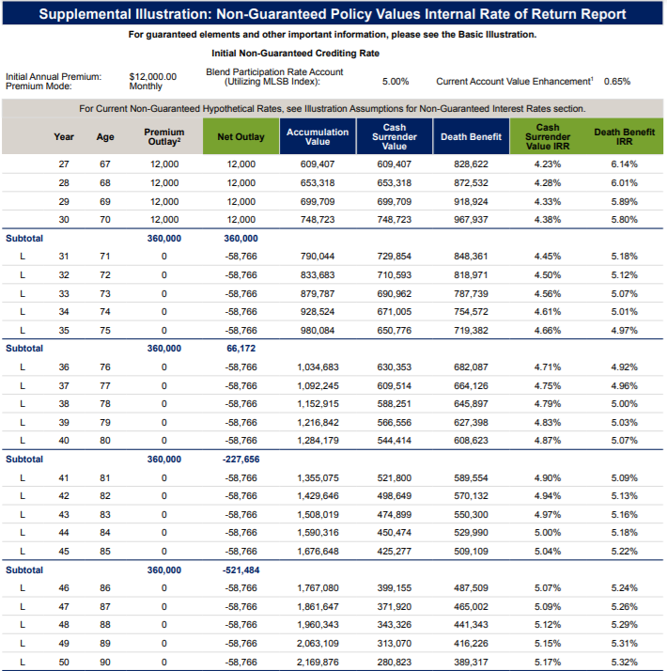
Not an actual case.
This is a hypothetical example for illustrative purposes only.
Values as of 7/28/2021. AG49-A & 7702 Compliant.
Past performance is not indicative of future results.
This slide is intended to help with the understanding of the product illustration and,
in particular, the meaning of the Cash Surrender Value IRR.
Although portions of the discussion equate these financial terms as they
apply to investments, life insurance is not intended to be an investment.
Notes:
This excerpt from the product illustration is intended to explain what the Cash Surrender Value IRR column means. This information is often misinterpreted, and it has a financial meaning.
This slide is intended to help the audience further their knowledge and understanding of the product illustration and, in particular, the meaning of the Cash Surrender Value IRR.
Although portions of the discussion equate these financial terms to financial terms as they apply to investments, life insurance is not intended to be an investment.
Here I’ve captured a portion of the illustration created by those assumptions.
In the second-last column you can see the “Cash Surrender Value IRR,” or Internal Rate of Return.
That column tells you what an alternate investment would need to earn, net of taxes and costs, in ALL PREVIOUS YEARS to generate the same cash surrender value show in the illustration.
For example, if I focus on year 27, in the third column you can see that the Premium "Net Outlay" of $1,000 per month creates a total of $12,000 per year.
That premium has been illustrated for 30 years.
The projected cash surrender value in the 27th year is $609,407; and it has an IRR of 4.23%.
What does that mean?
It means that $1,000-per-month would need to grow at 4.23% compound interest each-and-every-year for 27 years to achieve the same $609,407 value in the 27th year.
Toward the bottom of the column – at age 85 – you can see that the IRR has increased to 5.04%.
Applying the same logic, this means that paying $1,000 per month for 30 years, and taking out $58,766 from age 71 through age 85, it would take a 5.04% compound annual rate of return every year for 45 years to still have $425,277 of cash surrender value.
So how do we use this information to estimate the cost of the life insurance policy?
In the header of the illustration you can see that I projected a 5.00% interest rate.
Starting in year 6 the Max Accumulator+ II policy automatically adds an additional 0.65% of Account Value Enhancement, taking the total credited interest rate to 5.65% in all years after year 5.
When I compare my projected interest rate of 5.65% to the IRR of 5.04%, you can see that we’ve lost less than 1% of the projected rate of return to the costs of the policy.
In fact it's only about 61 basis points.
So, you could summarize the “overall 45-year cost” of the policy in terms Financial Advisors can understand… “If you were to keep this policy until age 85, based on these assumptions, the approximate annual cost is about six-tenths of 1%.”

Slide 15
Not an actual case.
This is a hypothetical example for illustrative purposes only.
Values as of 7/28/2021. AG49-A & 7702 Compliant.
Past performance is not indicative of future results.
Where else can you get:
tax-deferred-growth¹,
income-tax-free retirement distributions²,
income-tax-free to beneficiaries³, and
upside market performance opportunity
while eliminating market corrections & recoveries
for about 61 bps?
Based on current federal income tax laws.
Assumes the use of withdrawals to basis and/or policy loans. If the policy is classified as a modified endowment contract (see IRC section 7702A), withdrawals or loans are subject to regular income tax and an additional 10% tax penalty may apply if taken prior to age 59 ½.
Death Benefits are generally excludable from the beneficiary’s federal taxable income under most circumstances and under current federal income tax law.
This slide is intended to help with the understanding of the product illustration and,
in particular, the meaning of the Cash Surrender Value IRR.
Although portions of the discussion equate these financial terms as they
apply to investments, life insurance is not intended to be an investment.
Notes:
This excerpt from the product illustration is intended to explain what the Cash Surrender Value IRR column means. This information is often misinterpreted, and it has a financial meaning.
This slide is intended to help the audience further their knowledge and understanding of the product illustration and, in particular, the meaning of the Cash Surrender Value IRR.
Although portions of the discussion equate these financial terms to financial terms as they apply to investments, life insurance is not intended to be an investment.
So I ask you… “Where can you get tax-deferred-growth; income-tax-free distributions to you and your heirs, no required distributions, plus upside market potential with no market corrections and no waiting for market recoveries… all for about 61 bps? (bps = basis points)
I challenge you to find that anywhere else.

Slide 16
The Rule Of 25
The $5 - $10 - $20 Story
How Much Does
Life Insurance Cost?
Notes:
So there are your three topics for today:
The Rule Of 25;
The $5 - $10 - $20 Story; and…
How Much Does Life Insurance Cost
All three of these stories work in harmony.
The Rule Of 25 helps your clients and prospects see how much money they should be targeting in their savings by the time they retire. In many cases, this simple Rule Of 25 will reveal that they’re not on track to meet their goals, and they need to make additional contributions.
The $5 - $10 - $20 Story helps them to see how the tax advantages of life insurance may be able to help them achieve their goals.
The “How Much Does Life Insurance Cost” story shows them how cost-effective life insurance can be as an additional supplemental accumulation vehicle that can help them achieve their retirement goals.
Learn all three stories, and then learn how to tell them back-to-back so that your clients can see the value of including life insurance as part of their overall financial plans.

Slide 17
Any Questions?
AIG Financial Distributors is the sales and distribution arm for AIG’s US life insurance and retirement businesses.
Policies issued by American General Life Insurance Company (AGL), Houston, TX except in New York, where issued by The United States Life Insurance Company in the City of New York (US Life). Policy number ICC19-19646, 19646, 19646N Rev0120. Issuing companies AGL and US Life are responsible for financial obligations of insurance products and are members of American International Group, Inc. (AIG). AGL does not solicit, issue or deliver policies in the state of New York. Guarantees are backed by the claims-paying ability of the issuing insurance company. Products may not be available in all states and product features may vary by state. Please refer to your policy. ©2020 AIG. All rights reserved.
This material is general in nature, was developed for educational use only, and is not intended to provide financial, legal, fiduciary, accounting or tax advice, nor is it intended to make any recommendations. Applicable laws and regulations are complex and subject to change. Please consult with your financial professional regarding your situation. For legal, accounting or tax advice consult the appropriate professional.
FOR FINANCIAL PROFESSIONAL USE ONLY-NOT FOR PUBLIC DISTRIBUTION.
AGLC200423REV0921 Red Oak: 1823862
Notes:
Does anyone have any questions about anything we covered today?

Slide 18
3 Life Insurance Accumulation Concepts
Policies issued by American General Life Insurance Company (AGL), Houston, TX and by
The United States Life Insurance Company in the state of New York (US Life), members of American International Group, Inc. (AIG)
Notes:
Thanks for joining me today.
I hope you learned something that you can begin applying to your business immediately.
Here at AIG we look forward to providing you with the products, the services and the people that are the hallmark of AIG’s reputation.
And we thank you for everything you do to help your clients achieve and protect their lifetime of financial security.

