Slide 1
SecureCare
Universal Life
[Presenter name]
[Date]
Insurance products issued by Minnesota Life Insurance Company
Notes:
[note to speaker: each tab at the top of the slide represents a chapter of the presentation. Chapters can be shown in any order. You can choose to show as many or as few chapters as you’d like during a single presentation. Unless otherwise noted, you must show all the slides in a chapter once you start it. You must end every presentation by showing the disclosures.]

Slide 2
Our time today …
Company update
SecureCare basics
Why it’s unique
Sales concepts
Service excellence
Notes:
[Note to speaker: Identify which chapters you’ll be covering in the presentation. Each circle represents a chapter of the presentation. Chapters can be shown in any order. You can choose to show as many or as few chapters as you’d like during a single presentation. Unless otherwise noted, you must show all the slides in a chapter once you start it. You must end every presentation by showing the disclosures.]
[note to speaker: you can return to this slide at any time by clicking the “main menu” tab at the top]

Slide 3
Shared success creates enduring relationships
Notes:
Read the slide

Slide 4
About Securian Financial
By the numbers
8th largest
insurance company in the nation¹
$5.6 billion
in statutory benefits paid to customers in 2019
$93.4 billion
in assets under management
$1.3 trillion
of life insurance in force
More than
21 million customers across North America
1. A.M. Best’s Statistical Study, U.S. Total Life, July 20, 2020. Based on 2019 total life insurance in force for Minnesota Life Insurance Group
All statistics as of December 31, 2019, unless otherwise noted.
Notes:
Read the slide

Slide 5
The value of high ratings
Comdex ranking
96
(as of December 2020)
100 (highest)
A+
Superior
A.M. Best
AA
Very Strong
Fitch Ratings
Aa3
Excellent
Moody’s Investors Service
AA-
Very Strong
Standard and Poor’s
For more information about the rating agencies and to see where our ratings rank compared to other ratings, please view our website at securian.com/ratings.
All ratings information as of November 2020, unless otherwise noted.
Securian Financial is in the top 5 percent of companies with a Comdex ranking. The Comdex is a composite ranking of an insurer’s ratings assigned by independent rating agencies. More than 200 companies are ranked on a scale of 1 (lowest) to 100 (highest), making it easier to compare a company across all insurers rated by at least two rating agencies. The Comdex is a product of Ebix Exchange and is not a rating. For more information, visit ebix.com/vitalsales-suite.
A.M. Best Company rating (second highest of 16 ratings); Fitch rating (third highest of 19 ratings); Moody’s rating (fourth highest of 21 ratings); Standard & Poor’s rating (fourth highest of 21 ratings). For more information about the rating agencies and to see where our ratings rank compared to other ratings, please see our website at securian.com/ratings. Ratings for financial strength and claims-paying ability are important; however they are not reflective of the performance of any registered securities or variable subaccounts. All ratings information as of February 2020. Securian Financial Group, Inc., is a part of an insurance company holding group. These ratings are assigned to the following Securian Financial Group member companies: Minnesota Life Insurance Company and Securian Life Insurance Company.
1 (lowest)
Notes:
Read the slide

Slide 6
A new long-term care solution
Notes:
SecureCare is a new kind of long-term care (LTC) solution – let’s go over the basics of the LTC landscape and the SecureCare product.

Slide 7
The need for long-term care (LTC)
Need
Cost
Concern
Most retirees will need some form of LTC¹
Median annual cost of LTC between $50,000-$90,000²
Health care costs a top concern³
It’s time to care: a detailed profile of America’s Direct Care Workforce. Paraprofessional Healthcare institute. January 21, 2020. https://phinational.org/caringforthefuture/itstimetocare/
Calculate the cost of long-term care. LTCnews.com. 2020. https://www.ltcnews.com/resources/states/
Employee financial wellness survey. PwC. 2019. https://relay.sp.securian.com/enterprise/marketresearch/TargetMarkets/pwc-2019-employee-wellness-survey.pdf
Notes:
Most retirees need some form of LTC due to the simple fact that health declines with age. More seniors have chronic medical conditions, which increases the likelihood of needing LTC (70% of folks age 65 and above have two or more chronic health conditions; and there are currently 5.8 million people with Alzheimer’s disease, a number that’s expected to increase to 14 million by 2050. Nearly 75% of people with Alzheimer’s need LTC) ¹
In 2020, the national median annual cost for LTC is between over $50,000 for home care services to over $90,000 for nursing home care² – and the cost is rising
Fewer than 4 in 10 employees are confident they’ll be able to afford medical expenses in retirement³
Clearly there’s a good chance clients will need care … so how will they pay for it?
It’s important for clients to understand that Medicare doesn’t pay for LTC past 100 days and Medicaid only kicks in once a client’s assets have been nearly depleted. Some clients are counting on their loved ones to care for them if they need it, but being a caregiver can be challenging and we have several client-approved marketing pieces that really speak to the fact. Other clients may plan to self-insure, but as we’ll get into on the next slide, there can be issues with that as well.
It’s time to care: a detailed profile of America’s Direct Care Workforce. Paraprofessional Healthcare institute. January 21, 2020. https://phinational.org/caringforthefuture/itstimetocare/
Calculate the cost of long-term care. LTCnews.com. 2020. https://www.ltcnews.com/resources/states/
Employee financial wellness survey. PwC. 2019. https://relay.sp.securian.com/enterprise/marketresearch/TargetMarkets/pwc-2019-employee-wellness-survey.pdf

Slide 8
Why is having a long-term care plan important?
Income: $80,000
Living expenses: $60,000
LTC expenses: $75,000
Total expenses: $135,000
Investments/retirement savings
Tangible assets (home, car, cabin)
Liquid assets
Life insurance
LTC benefit
LTC expenses: $75,000
LTC plan
This is a hypothetical example for illustrative purposes only.
Notes:
A big challenge for many agents is knowing how to position the importance of long-term care to clients.
And many clients (particularly more affluent ones) may look at their retirement portfolio and think, “I have X dollars in my portfolio and I’ll be taking out $80K/year for income. I anticipate my expenses will be $60K/year. My income can cover my expenses, and my annual income doesn’t exceed my portfolio’s expected rate of return, so my retirement income should last as long as I need it. Plus, if I need LTC, that will probably cost me about $75K/year, for maybe 2-3 years. $75K is still less than my annual income, so self-insuring makes sense. Why would I take money out of my portfolio that could be generating additional income if I left it in there, when I can afford to self-insure?”
Here’s the issue: when clients (and some agents) do this back of envelope math, they often fail to grasp that the LTC expenses are in addition to their other living expenses. So the $75K for LTC expenses is in addition to the other $60K expenses, which means the client’s expenses are $135K. Whatever money they’re short, that’s going to come out of the retirement portfolio, which means an LTC event could put the client in a position where they’re having to take more money out of their portfolio than it can replenish, which could deplete their assets.
But what happens if they take some of those assets already earmarked to pay for care and purchase a long-term care plan? Instead of solely relying on their retirement portfolio to cover any future LTC expenses, they can use the benefit provided by their policy. Essentially, having an LTC plan is important because it gives clients an additional pool of money they can draw from to help pay for care expenses, so they don’t have to put quite as much stress on their portfolio.
Think of it this way: you and your client have worked hard to create a retirement portfolio that can provide them with the income they need to sustain their standard of living for as long as they’re alive. But without a long-term care plan in place, decades of planning can be completely thrown off by LTC expenses and put the entire portfolio at risk.

Slide 9
$100,000
Single premium
Total LTC benefits
Max monthly benefit:
$6,882
Extension of LTC benefits
Acceleration for LTC benefits
■ Day 1: $98,474
■ Age 80: $167,645
2-year benefit
■ Day 1: $215,303
■ Age 80: $366,540
4-year benefit
■ Day 1: $313,777
■ Age 80: $534,185
6-year benefit
This is a hypothetical example for illustrative purposes only.
Notes:
How SecureCare Universal Life Insurance works.
Hypothetical example with 62 y/o female, Long-Term Care Inflation Protection Agreement with 3% compound interest, NT couples discount
[read the slide]
Plus, residual death benefit is: $10,000
Minimum death benefit is: $110,116

Slide 10
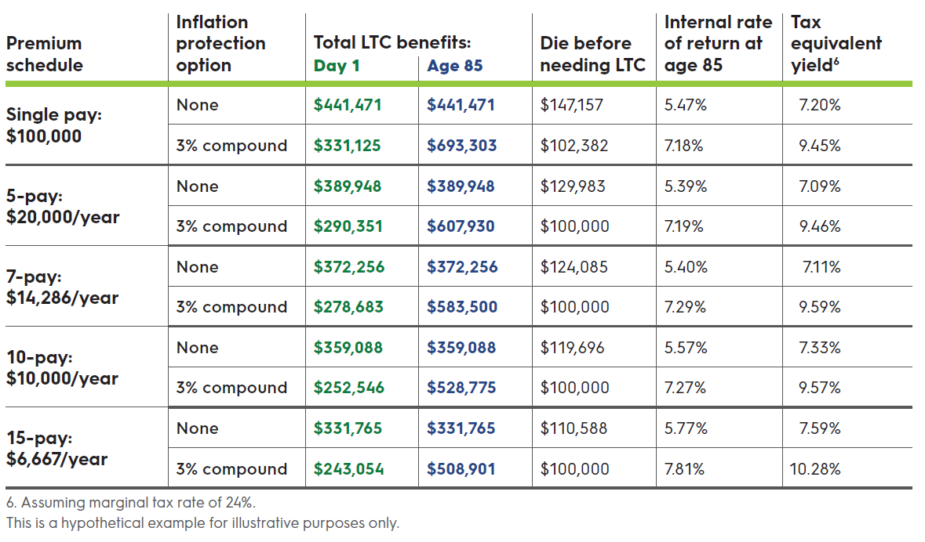
Coverage options
Notes:
To help get a better sense of how SecureCare works, let’s look at the different coverage options available to a 60 year old female client (couples discount, NT), if she wanted to purchase a SecureCare policy for $100,000 total premium.
[read slide]
As the cost of care continues to rise, consumers need a solution that can help maximize and guarantee each dollar. As you can see, SecureCare can help provide this leverage.

Slide 11




Product features
Multiple premium options (5, 7, 10 or 15 years)
Cash indemnity LTC benefit
Reduced paid-up benefit¹
Return of premium (ROP)²
Minimum death benefit
Issue ages: 40-75
Face amounts: $50,000 - $750,000
90 calendar day elimination period (zero days for home modification and caregiver training)
Reduced paid-up benefits refers to the reduced paid-up nonforfeiture benefit that purchases paid-up insurance in the event of premium lapse.
Upon surrender, the policy owner will receive the surrender value proceeds. The surrender value proceeds may not equal the sum of premiums paid. Surrenders are subject to a return of premium vesting schedule. Policies that are fully vested are eligible for a full return of all premiums paid.
Notes:
Multiple premium options (5, 7, 10 or 15 years) – client can choose to pay premiums monthly, bi-annually, or annually, with no modal factor.
Cash indemnity LTC benefit – no restrictions or fine print about how benefit can be used. The client can use their cash benefit however they want, whether that means paying a family member or friend for providing informal care, modifying their house, etc. Clients can also save their benefit so they’ll have that money banked for later – ultimately their benefit is their money and they can use it however they want.
Reduced paid-up benefit – if something changes in your client’s financial situation and they’re no longer able to afford their premiums, instead of having to cancel their policy, they can simply get a policy with a smaller benefit based on the premiums they’ve already paid in
Return of premium – clients are guaranteed full return of premium. For a single pay, they can get their full ROP back after they complete the fifth policy year. For a multi-pay policy, the full ROP is available after the client completes their last payment year. So if a client chooses a 7-pay, the full ROP would be available after the 7th year. A 10-pay, full ROP is available after the 10th year, etc.
Minimum death benefit – even if the client totally exhausts their LTC benefit, their policy will still provide a guaranteed minimum death benefit. The guaranteed minimum death benefit is whichever is less: $10,000 or 10% of the policy’s original face value.
Issue ages 40-75 but SecureCare’s maximum payment age was increased from age 75 to age 80 in most states in 2020.
Face amounts: $50,000 - $750,000
90 calendar day elimination period (zero days for home modification and caregiver training). Elimination period starts when insured is certified as chronically ill, not when the claim is made.

Slide 12
Innovation creates client solutions
Notes:
At Securian Financial, we believe innovation creates client solutions – that’s why SecureCare was designed to stand apart from its competition. Let’s take a look at what makes SecureCare unique.

Slide 13
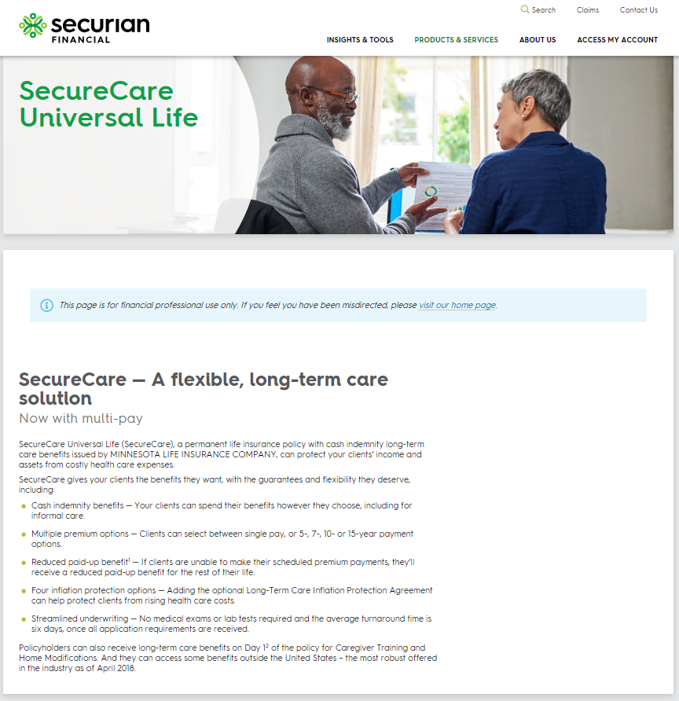
Five key questions a LTCi product should answer
How do clients receive LTC benefits?
How can clients keep up with the rising cost of care?
Access product information and sales tools at:
securian.com/securecare
What protections do clients have in place?
What are the tax benefits?
What happens if clients travel abroad?
Notes:
To understand what makes SecureCare unique, There are five key questions a long-term care insurance product should answer [read slide]. Let’s look at [speaker identifies section they’ll be covering].
[note to speaker: you do not need to show every slide in this chapter in one presentation. Each green box represents a section. You must show all slides in a single section, but the sections can be shown in any order and you can choose to show as many or as few sections as you’d like during a presentation. You must end every presentation by showing the disclosures.]

Slide 14
How do clients receive LTC benefits?
Notes:
[Read the slide]

Slide 15
LTC is changing
Aging baby boomers
What will the care network look like in 7 years?
Evolving family dynamics
Caregiver shortage
Notes:
Before we get into how clients receive LTC benefits, let’s just consider the LTC landscape:
We have an aging population: 10,000 baby boomers will turn age 65 every day until 2030.¹ From 2016 to 2060, the population of adults aged 65 and over will almost double, from 49.2 million to 94.7 million and the number of adults over 85 will nearly triple, from 6.4 million to 19 million²
Family dynamics are changing and there aren’t enough working-age adults to care for all the baby boomers. Currently, there are 31 working-age adults for every adult aged 85 and over. But by 2060, that number will shrink to 12.² This all begs the question: Who will care for clients?
And at the same time, just as more seniors need care, we’re facing a caregiver shortage: by 2028, 8.2 million paid care jobs will need to be filled. This number is pretty staggering, especially when you consider that LTC employers already struggle to fill existing positions³. Will the type of care clients want be immediately available?
When you consider all these factors, it’s clear the LTC landscape is changing. Most claims begin when the client is over 80 years old⁴, which means it’s likely there will be a huge need for LTC in about 7-10 years. What will the care network look like in 7 years, when the first baby boomers start to reach average LTC claim age? Who will care for them? And what type of care will be available?
We don’t know, but we do know that in the face of all those changes, helping clients create a plan that maintains their flexibility and freedom is key.
1) “2020 Census will help policymakers prepare for the incoming wave of aging boomers”, US Census Bureau, Dec. 10, 2019. https://www.census.gov/library/stories/2019/12/by-2030-all-baby-boomers-will-be-age-65-or-older.html
2) Understanding the direct care workforce. Paraprofessional Healthcare Institute. 2020. https://phinational.org/policy-research/key-facts-faq/
3) From Crisis to Emergency: 8.2 Million Direct Care Job Openings Expected by 2028. Stephen Campbell. January 24, 2019. https://phinational.org/news/new-research-7-8-million-direct-care-jobs-will-need-to-be-filled-by-2026/
4) Long-term care insurance facts – data – statistics – 2019 report. American Association for Long-term Care Insurance. 2019. http://www.aaltci.org/long-term-care-insurance/learning-center/ltcfacts-2019.php#2019ages

Slide 16
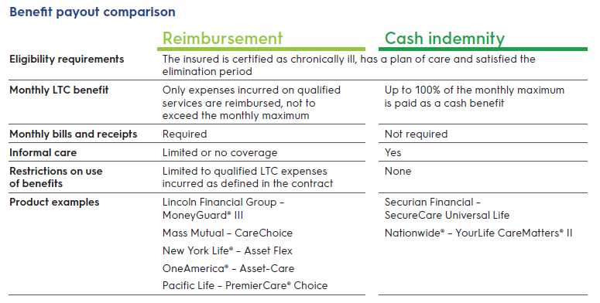
Cash indemnity vs. reimbursement
This comparison does not take all material factors into account and must not be used with the public. These factors include but are not limited to: availability, surrender periods, or fees and expenses. For information regarding these and other factors please consult each company's respective policy guide.
Notes:
So with the need for flexibility and freedom in mind – let’s take a look at the two main ways LTC benefits are paid: reimbursement vs. indemnity. With both policy types, the insured qualifies for benefits when they are certified as chronically ill by a licensed health care practitioner, have a plan of care in place and have satisfied their policy’s elimination period.
But then what happens when a client goes on claim?
With a reimbursement policy, the policyowner would be reimbursed, dollar per dollar, for actual expenses incurred. The client would first have to pay their LTC expenses out out-of-pocket, and then submit receipts to the carrier to be reimbursed and only those expenses that are covered by the contract will be reimbursed.
With a cash indemnity policy on the other hand, the policyowner will automatically be sent a monthly cash benefit regardless of actual expenses once they go on claim. The policyowner can use their benefit however they want: informal care, medical equipment, home maintenance, or save it to use down the road.
You can see on the slide how these two different benefit types compare – let’s run through. The differences quickly.
[Read the slide]
Ultimately, cash indemnity can provide clients with the flexibility and freedom they’ll need. A cash indemnity plan can help support a client’s plan for care, instead of dictating it.

Slide 17
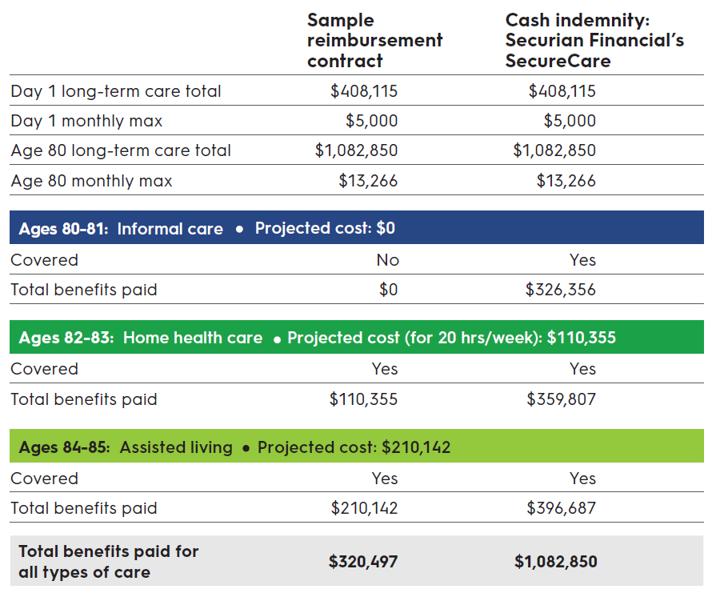
Achieving leverage
$762,353 more benefits paid over six years with cash indemnity vs. reimbursement
This is a hypothetical example for illustrative purposes only.
Notes:
Since most care generally begins in the home and requires a combination of formal/informal care¹, the cash indemnity model is ideal because it allows your client to access their benefits earlier and because the monthly maximum benefit payment is not limited to actual expenses incurred, clients may be able to get more out of their policy.
Let’s look at an example that compares a hypothetical reimbursement contract with a SecureCare policy that has a six-year benefit period and a 5 percent compound interest inflation benefit. In the example, the client has the same total benefit pool available to her with each policy type and it assumes the client bought the policy at age 60 and then goes on claim at age 80.
The scenario shows the client’s care beginning in the home with an informal caregiver (spouse, child, etc.) and then transitioning to an assisted living facility as the condition progresses over six years.
The projected cost of care is calculated using the 2020 national median for a home health aide ($27.82/hour) and assisted living facility (50,924/year) and assumes a 3% national inflation each year².
[Read through example on slide]
So even though the client has the same total benefit pool available with each policy, the amount of benefits she actually receives varies drastically: the cash indemnity policy pays $762,353 more benefits paid over 6 years than the reimbursement policy.
1. Long-Term Care Insurance Facts - Data - Statistics - 2019 Report. American Association for Long-Term Care Insurance. January 2019. https://www.aaltci.org/long-term-care-insurance/
learning-center/ltcfacts-2019.php
2. Calculate the cost of long-term care. LTCnews.com. 2020. https://www.ltcnews.com/resources/states/

Slide 18
How can clients keep up with the rising cost of care?
Notes:
Read slide

Slide 19
Cost of care
National annual medians
1
2
2
Costs of care. US Department of Health and Human Services. 2016. https://longtermcare.acl.gov/costs-how-to-pay/costs-of-care.html
Calculate the cost of long-term care. LTC News. 2020. https://www.ltcnews.com/resources/states/
Notes:
If all LTC planning encompassed was coming up with a strategy that would help clients cover today’s cost of care, that would be a daunting a task, given today’s prices. But LTC planning is about helping clients prepare for care costs that are potentially years down the road, when the cost of care is projected to be much higher than it is today.
So when you’re helping a client design a LTC plan, it’s important to consider whether their LTC benefit will be able to keep up with the rising cost of care.

Slide 20
Inflation protection:
opportunity to keep up with cost of care
This is a hypothetical example for illustrative purposes only.
Notes:
SecureCare offers multiple inflation options: we offer 3% and 5% in simple and compound
The cost of the inflation benefit may vary depending on the policy design, the client’s age, gender, etc. so having four different inflation options helps us find the option that offers the most value to your client.
SecureCare’s options allow inflation protection to work with older clients
SecureCare’s inflation benefit continues to grow even after claim is initiated
This chart shows the ages at which the total LTC pool of a policy with the inflation agreement will either match or surpass the LTC pool of a policy that does not include inflation during the same benefit period.

Slide 21
What protections do clients have in place?

Slide 22
Four guarantees
Long-term care
Death benefit
FOUR GUARANTEES
Female, age 62
$100K 5-pay policy
Reduced paid-up benefit
Return of premium
Notes:
With SecureCare, clients have four key guarantees in place:
To understand them, let’s look at an example of a 62 y/o female who purchases a $100K five-pay policy with 3% compound interest, non-tobacco couples discount.
[NOTE TO SPEAKER: when you are giving the slideshow, to show more details about each of the four guarantees, click on each colored segment of each guarantee to be taken to a slide that shows additional information about the guarantee. When you’re done talking about a specific guarantee and want to return to this slide, click the white background.]

Slide 23
What are the tax benefits?
Notes:
Read slide

Slide 24
SecureCare’s tax implications
Benefits
Cash indemnity benefit not taxed as income – unless above IRS per diem ($400 in 2021)
Policy structure
Face amount (base life insurance)
Not deductible (life)
Acceleration for LTC Agreement
Extension of LTC Benefits Agreement
LTC Inflation Protection Agreement
Deductible
(LTC)
Notes:
[read slide]
There are two parts to a SecureCare premium: the portion that goes towards the life insurance and the portion that goes towards the tax-qualified LTC agreements. Clients may be able to deduct the LTC portion of their premiums, subject to the age-based limitations set by the IRS.

Slide 25
SecureCare’s potential tax deductibility
Individual
  Deduct whichever is less: the age-based limit or the LTC portion of their premium; must itemize taxes
Owner/employee of pass-through entity
  Deduct whichever is less: the age-based limit or the LTC portion of their premium; don’t need to itemize
Employee and owner/employee of C corporation
  Exclude full LTC portion of their premium from income; no age-based limitation
Attained age | 2021 limit
40 or less | $450
41-50 | $850
51-60 | $1,690
61-70 | $4,520
71+ | $5,640
Notes:
Here’s a quick overview of how SecureCare’s tax deductibility can work. You can see the IRS’s age-based limitations for 2021 on the right.
For individuals: They must have medical expenses greater than 7.5% of their adjusted growth income and itemize their taxes to qualify for a deduction. Then they can deduct whichever is less: the age-based limit or the LTC portion of their premium.
If a pass-through entity decides to provide SecureCare policies to valid class of employees, the owner/employee of pass-through entities can deduct whichever is less: the age-based limit or the LTC portion of their premium as an above-the-line deduction (so don’t need to itemize)
For employees (of any company structure) who receive SecureCare policies from their company, and for owners/employees of C corporations, they can exclude the full LTC portion of their premium from their income (no age-based limitations)

Slide 26
What happens if clients travel abroad?
Notes:
Read slide

Slide 27



International benefits¹
SecureCare has most robust international benefits in the industry²
  Benefit pool stays the same
  50% of monthly maximum benefit – no limitations
Qualified long-term care services received outside the United States, its territories or possessions are limited to the non-United States monthly benefit limit. If the insured returns to the United States, the non-United States monthly benefit limit will no longer apply.
Based on competitive research as of 06/2020
Notes:
SecureCare has most robust international benefits in the industry²
Benefit pool stays the same (both the base contract and extension of benefits are available)
50% of monthly maximum benefit – no limitations
6 year benefit period would become a 12-year benefit period because the client would be getting 50% of their monthly maximum

Slide 28
Concepts that help close cases

Slide 29
SecureCare sales concepts
Tax strategies
Advantages of multi-pay
Access product information and sales tools at:
Securian.com/securecare
HSA funding strategy
RMD funding strategy
Value of ROP
Marketing plan
Notes:
[Note to speaker: Identify which sections you’ll be covering in the presentation. You do not need to show every slide in this chapter in one presentation. Each green box represents a section. You must show all slides in a single section, but the sections can be shown in any order and you can choose to show as many or as few sections as you’d like during a presentation. You must end every presentation by showing the disclosures.]

Slide 30
Tax strategies
Notes:
Read slide

Slide 31
Individual

Slide 32
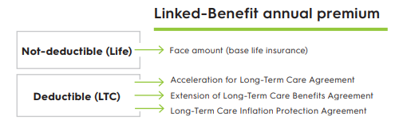
Tax implications for individuals
1.
Determine amount of LTC premium paid
2.
Find age-based limitation
Attained age | 2020 limit | 2021 limit
40 or less | $430 | $450
41-50 | $810 | $850
51-60 | $1,630 | $1,690
61-70 | $4,350 | $4,520
71+ | $5,430 | $5,640
3.
Include the lesser amount as an itemized deduction
Notes:
Quick overview of how SecureCare’s tax deductibility can work for individuals
Step 1 is to determine the LTC portion of the premium, separate from the life insurance portion. For SecureCare, there are three parts of the premium that can be deducted: [read slide]. You can find these on the policy page.
Step 2: find age-based limitation
Step 3: Client needs to itemize their taxes in order to take the deduction, which would be whatever amount is less, step 1 or step 2 (client can deduct the lesser of the LTC premium or age-based limitation).

Slide 33



Individual examples
Mike, age 55
  Annual LTC premium: $5,000
  Age-based limit: $1,690
  Deduction = $1,690
Mariana, age 72
  Annual LTC premium: $5,000
  Age-based limit: $5,640
  Deduction = $5,000
These are hypothetical examples for illustrative purposes only.
Notes:
Let’s run through a couple of examples:
[Read slide]

Slide 34
Where are the itemized deductions?
Current income
− Above-the-line deductions
Adjusted gross income (AGI)
− Standard deduction OR itemized deduction
Taxable income
Notes:
So now you know the amount of the deduction. Where is the deduction on the form 1040?
This slide is a simplified outline of the Form 1040. At the top is all current income. Next are the above the line deductions, which gets the taxpayer to the adjusted gross income. After the adjusted gross income is calculated, the taxpayer has a choice of using the standard deduction or the itemized deduction – they’ll want to choose whichever amount is greater.
Given that the 2017 tax law change almost doubled the standard deduction (in 2021 the standard deduction for married filing jointly is $25,100 and single is $12,550), it’s likely taking the standard deduction will give many clients the higher deduction amount.

Slide 35
Who will get the itemized deductions?
Clients who:
  are older (higher age-based limitation)
  have large amounts of out-of-pocket medical expenses
  live in states with high state taxes
  make large charitable gifts
  pay large amounts of mortgage interest
Notes:
However, some clients may itemize their deductions.
There are four main itemized deductions:
Medical expenses – if client has medical expenses that exceed 7.5% of their AGI, they can itemize medical expenses that were not reimbursed or paid out of pocket. This is where the LTC premiums can be paid. Remember the deduction is the lesser of the premiums paid or the age-based limit
State and local taxes – 2017 tax law change – a federal law limits this amount to $10,000 (regardless if you are married filing jointly or single)
Charitable deduction – 2017 tax law change – it is now 60% of AGI for cash gifts (it was 50%)
Mortgage interest
With that in mind, clients who will likely be able to benefit from paying LTC premiums as an itemized deduction:
Older ages – because of the age-based limitations (the older you are the more you are able to deduct)
Out-of-pocket medical expenses, high state tax, large charitable gifts and mortgage interest will increase the itemized deduction over the standard deductions

Slide 36
Business-sponsored arrangements
Notes:
Let’s move to business sponsored arrangements.
Companies may choose to provide a valid class of employees with SecureCare policies. In these cases, the company pays the premiums, but each member of the valid class owns their individual policy.
Please note – Clients must be mindful of discriminatory benefits in the employment setting. If they only offer benefits to only a select employees without defining a class of employee who will be offered the benefit and the benefit is only for the highly compensated employees, then this may invite scrutiny of the IRS.
The tax benefits from this section are based on the Internal Revenue Code Section 105 – Amounts received under accident and health plans
Please check the business’s legal and/or tax professionals on the eligibility of these income tax benefits.
Please note – These benefits can also be included for spouses and dependents of business owners and employees. Please check with client’s tax professional on the legal and/or tax implications on extending the benefit to these individuals.

Slide 37
Owner/employee of pass-through entity
$
Pass-through entity
SecureCare
Owner/employee
Notes:
An important aspect of pass-through entity taxation is there is only one level of taxation and all business income “passes though” to the business owner.
If the business pays the premium for the business owner (also an employee), then the owner will be able to make the deduction as an above the line deduction.
This deduction is the lesser of the LTC premium or the age-based limit.

Slide 38
Where are the above-the-line deductions?
Current income
- Above-the-line deductions
Adjusted gross income
- Standard deduction OR itemized deduction
Taxable income
Notes:
So where are the above-the-line deductions?
Again, this is a simplified outline of the Form 1040. At the top is all current income, next are the above the line deductions (this is where the business owner gets the deduction) which gets the taxpayer to the adjusted gross income.
Here you can see how above-the-line deductions are typically more beneficial than itemized deductions for pass-through entity owner because you don’t need to itemize your taxes to take the deduction.

Slide 39
Case study: Tyrone (S corporation owner/employee)
$
$10,000/yr for 10 years
XYZ Corporation
SecureCare
Employees
$100,000 policy
This is a hypothetical example for illustrative purposes only.
Notes:
Let‘s go through an example.
Tyrone (age 55) is employee/owner of XYZ Corporation (S corporation) and has two employees. He wants to provide SecureCare to both himself and his employees. And XYZ is willing to pay $10,000 premiums for 10 years for Tyrone and the other two employees. Let’s look at what this would mean for Tyrone.

Slide 40
Tax implications for Tyrone (S corp owner/employee)
$100,000 premium paid over 10 years
  Annual premium: $10,000
    Face amount: $5,938
    Acceleration for Long-Term Care Agreement: $981
    Extension of Long-Term Care Agreement: $714
    Long-Term Care Inflation Protection Agreement: $2,367
Tyrone’s age | Age-based (assuming no inflation) | Number of years | Total deductible amount
55-60 years old | $1,690 | 6 | $10,140
61-64 years old | $4,062 | 4 | $16,248
This is a hypothetical example for illustrative purposes only.
Notes:
To see how this works for Tyrone, the first step is to determine the amount of LTC premium paid, which is $4,062.
Second step is to find Tyrone’s age-based limit – from ages 55-60 years old that’s $1,690. So for each of these six years, Tyrone can deduct whichever is less: his age-based limit or the LTC portion of his premium (a total of $4,062). In this case, his age-based limit is less, so he can take $1,690 as an above-the-line deduction. From ages 61-64 years old, the lesser of the two amounts is the LTC portion of his premium. So for each of those four years, he can deduct $4,062.
Notice on the chart below that the older Tryone gets the more of a deduction he will receive because the age-based limitations increase the older the client gets.
Any remainder of the LTC portion of the premium, plus the life portion of the premium, would still be included in his income.

Slide 41
Owner/employee of C corporation
$
C corporation
SecureCare
Owner/employee
Notes:
Let’s move to C corporations. They are taxed differently than pass-through entities because there are two levels of taxation.
2017 tax law change – New business income tax rate is a flat 21%, this may be a decrease of 14% for some C corporations. It also means that they have more cash in the corporation. The challenge is how to get the cash out to the owners in the most tax-efficient manner.
In general, the cash coming out of the business is either compensation (ordinary income) or qualified dividend (long term capital gains). One tax-efficient solution is to take earnings from the business by paying the owner (who is also an employee) and employees to pay for SecureCare premium payments.
The company pays the SecureCare premiums, which are fully tax deductible to the business. If the C corp’s owner is also an employee, they can exclude the full LTC portion of the premium from their income – without being subject to any age-based limits. The life portion of the premium would be included in income.

Slide 42
Case study: Nancy (C corporation owner/employee)
$
$20,000/yr
For 5 years
XYZ Corporation
SecureCare
Nancy
(C corp owner/employee)
$100,000 policy
This is a hypothetical example for illustrative purposes only.
Notes:
Let’s look at an example.
XYZ Corporation (C corporation) wants to provide SecureCare policies to a valid class of employees, which includes Nancy, an owner/employee. XYZ will pay $20,000 for 5 years for Nancy and the other employees. Let’s look at what this would mean for Nancy.

Slide 43

Case study: Nancy (C corp owner/employee)
Nancy
 | Premium amount | Tax implication
Face amount (base life insurance) | $5,057 | Included in income (Life)
Acceleration for Long-Term Care Agreement | $1,836 | Not included in income (LTC)
Extension of Long-Term Care Benefits Agreement | $1,353
Long-Term Care Inflation Protection Agreement | $11,754
Annual business tax deduction of $20,000
This is a hypothetical example for illustrative purposes only.
Notes:
XYZ corporation can deduct the full $20,000 premium.
For Nancy, the life portion of the premium – the face amount – will be included in her income. But the LTC portion of the premium will not be included ($14,943). Over the 5 years the premium is being paid, this would mean Nancy could exclude $74,715 from her income (and would only have to include $25,285 as income).

Slide 44
Alternate strategy: split premium payments
(Life portion only)
$
(LTC premium only)
$
XYZ Company
SecureCare
Nancy
Notes:
If Nancy wanted to minimize the tax implications of her SecureCare policy as much as possible, another option would be to split the premium payments. In this scenario, the company would pay for the LTC portion of the premium only, while Nancy would fund the life portion of her policy using her own dollars.
So if XYZ company paid for the LTC portion of the premium only, it would pay $14,943 towards Nancy’s policy every year for five years, and it would still be able to deduct this amount. And just like in the other scenario, Nancy would still be able to exclude the LTC portion of the premium from her income. The difference would be that instead of having XYZ Company pay for the base life insurance of her policy, Nancy would cover that portion of the premium ($5,057) using her personal funds, which would mean she would not need to include it in her income.

Slide 45
Tax implications for employees
$
Company
SecureCare
Employees
Notes:
Finally, let’s look at tax implications for employees.
These should look familiar – the tax benefits to employees works the same way as tax benefits to owners/employees of C corporations.
The company (regardless of its business structure) can deduct the full SecureCare premium (both life and LTC) it pays for each employee.
The employee can exclude the LTC portion of the premium from their income – they only have to include the life portion.

Slide 46
Case study: Employee tax implication
Nancy
 | Premium amount | Tax implication
Face amount (base life insurance) | $5,057 | Included in income (Life)
Acceleration for Long-Term Care Agreement | $1,836 | Not included in income (LTC)
Extension of Long-Term Care Benefits Agreement | $1,353
Long-Term Care Inflation Protection Agreement | $11,755
Annual business tax deduction of $20,000
This is a hypothetical example for illustrative purposes only.
Notes:
Let’s look at that example with Nancy again, but let’s imagine Nancy is just an employee of the company she works for, not an owner.
The tax implications for both the company and Nancy would be the same:
The Company can deduct the full $20,000 premium.
For employee, the life portion of the premium – the face amount – will be included in their income. But the LTC portion of the premium will not be included ($14,943).

Slide 47
Positioning multi-pay
Notes:
While a single-pay policy provides more leverage than a multi-pay, not all clients are willing or able to afford purchasing a policy in one lump sum. That’s when SecureCare multiple premium payment options: 5-, 7-, 10- and 15-years, can really come into play. Another bonus: Securian Financial pays full comp on a multi-pay policy (as if single-pay)

Slide 48
Benefits of multi-pay
Flexibility
Liquidity
Opportunity
Notes:
A multi-pay policy still offers clients all the same guarantees as a single-pay policy: guaranteed premiums will never increase, guaranteed return of premium, guaranteed reduced paid up benefits and guaranteed LTC benefits.
A multi-pay also offers:
Flexibility: Clients can choose the premium duration that works for them: 5, 7, 10 or 15 years. And while the max issue age for a policy is 75, payment durations extend to age 80 (so a 70-year old could get a 10-pay). Plus, clients can choose to pay their premium annual, semi, quarterly or monthly without any modal factor.
Liquidity: Multiple premium payments can help clients avoid liquidity risk in the event of poor market conditions
Opportunity: Thanks to the flexibility and liquidity it offers, a multi-pay option can create LTC opportunities for more clients.
Ultimately, Knowing how to leverage SecureCare’s multi-pay options with clients can open the door to some compelling sales concepts

Slide 49

Plan outside the box
    Age: 65
    $105,000 policy, 5% compound inflation
    6-year benefit period
    $583/month ($7,000 annually) for 15 years
LTC protection
Day 1: $222,995
Age 85: $591,672
This is a hypothetical example for illustrative purposes only.
Notes:
A lot of clients (and agents) think of LTC protection as a step at the end of the retirement planning process – and a step only some clients can afford to take. But by leveraging a multi-pay option, you can start doing LTC planning outside the box.
A multi-pay policy can help you bring LTC protection to clients who are more middle market. Again, let’s think about the incredible need and cost of LTC: if we know that an American turning 65 today will incur an average of $138,000 in future LTC costs¹ and yet the average household only has around $9,000 in savings², that’s a pretty big gap.
It’s important to help clients understand that some coverage is better than no coverage – and by leveraging multi-pay, especially if you’re able to help clients take advantage of SecureCare’s pay to 80 option (which is pending approval in some states, but available in most), you can design a solution that offers LTC protection, guaranteed benefits, helps minimize their liquidity risk, offers flexibility if their financial situation changes down the road and they want to reduce their coverage or get their money back AND fits in their budget.
Let’s look at an example [read slide]
The client could pay quarterly or monthly with no modal factor, on day 1 of their policy they’d have $222,995 for LTC protection. By age 85, that would be $591,672. If they die before needing care, their beneficiaries would get $105,000. And their beneficiaries would get a guaranteed minimum death benefit of $10,000 even if their LTC benefit pool was depleted.
SecureCare’s four guarantees really play well with this strategy – if the client can no longer pay they still have guaranteed coverage via their reduced paid-up benefits (RPU). Their vesting schedule and inflation continue even after RPU. Ultimately, no matter what happens, the client is guaranteed to get something out of their premium dollars
1. Long-term services and supports for older americans: risks and financing research brief. Melissa Favreault. Feb. 2016. https://aspe.hhs.gov/basic-report/long-term-services-and-supports-older-americans-risks-and-financing-research-brief
2. We Can Do Better: How Our Broken Long-Term Care System Undermines Care. Paraprofessional Healthcare institute. April 21, 2020. https://phinational.org/caringforthefuture/wecandobetter/

Slide 50
Approval rates for LTC coverage decrease with age
84%
79%
76%
67%
56%
48%
Under 50
Age 50-59
Age 60-64
Age 65-69
Age 70-74
75 or older
“Long-Term Care Insurance Facts - Data - Statistics - 2019 Report.” American Association for Long-Term Care Insurance. http://www.aaltci.org/long-term-care-insurance/learning-center/ltcfacts-2019.php.
Notes:
Most clients don’t start thinking about planning for LTC needs until they’re older, but it’s important to have the LTC conversation with clients of all ages. Leveraging SecureCare’s multi-pay options can be a great way to help younger clients get a jump on LTC planning.
Read the slide
Typically, the best time to get LTC coverage is when the client is younger because approval rates for LTC coverage decreases with age. But it’s a small subset of clients who can afford a single-pay policy at 45. Leveraging a multi-pay option means the client can lock in their insurability while they’re younger, without sacrificing their other financial priorities.
Let’s look at two potential strategies to help you leverage multi-pay with younger clients: a minimally funded policy and sandwich generation funding idea.

Slide 51

Minimally funded, maximized protection
    Age: 50
    $50,000 policy, 3% compound inflation
    6-year benefit period
    $302/month ($3,627 annually) for 15 years
$455,030
LTC benefit by age 85
This is a hypothetical example for illustrative purposes only.
Notes:
Have the LTC conversation with clients of all ages, not just older folks.
When a younger client is interested, run a proposal with a $50,000 face amount (the minimum), structure the premium payments for as long as possible, then solve for the premium. The client could pay monthly with no modal factor.
So let’s say a 50-year-old female (non-tobacco, couples discount) gets a 15-pay with a $50K face, 3% compound inflation, and 6-year benefit period.
For $302 per month (or $3,627 annually), she could have an LTC benefit pool of over $450K by age 85.
Again, SecureCare’s four guarantees really play well with this strategy – if the client can no longer pay they still have guaranteed coverage via their reduced paid-up benefits (RPU). Their vesting schedule and inflation continue even after RPU. Ultimately, no matter what happens, the client is guaranteed to get something out of their premium dollars
This can be a great strategy to use with married couples as it can help each spouse get coverage. If both spouses end up needing some LTC, they’ll each have a benefit pool to draw from. And if one spouse passes before needing LTC, their policy’s death benefit can be left to the surviving spouse.
Let’s look at another quick example:

Slide 52

Minimally funded, maximized protection
    Age: 50
    $50,000 policy, 3% compound inflation
    6-year benefit period
    $302/month ($3,627 annually) for 15 years
    Age: 53
    $50,000 policy, 3% compound inflation
    6-year benefit period
    $280/month ($3,362 annually) for 15 years
$455,030
LTC benefit by age 85
$416,417
LTC benefit by age 85
This is a hypothetical example for illustrative purposes only.
Notes:
If the client from the previous example was married, let’s look at what a policy on her spouse could do:
[read slide]

Slide 53
Sandwich generation funding idea
$
$4,909/year for 15 years
Parents
SecureCare
Adult son
$50,000 policy
Day 1: $170,048 total LTC benefits
Age 80: $1,197,135 total LTC benefits
This is a hypothetical example for illustrative purposes only.
Notes:
Another option? If you’re talking to clients who see the benefit of LTC coverage and have adult children, they could fund a SecureCare policy for their adult child. This can be a great option and a unique way to get the LTC conversation started.
Here’s how it could work:
Son would own the policy, but the parents would pay the premium. Let’s say the son is 40 years old and parents get a $50K policy with 5% compound inflation and pay it over 15 years. On day 1, their son would have $170,048 total LTC benefits and by age 80, he’d have $1,197,135 total LTC benefits.
If the parents die before the policy is fully funded, the son can either start paying the premium or he could get a reduced paid up policy. It’s a huge way to help clients jumpstart their LTC planning.

Slide 54
The gift of LTC protection
$
$15,000/year for 5 years
Adult daughter
Parents
SecureCare
Age 85: $921,801 total LTC benefits
Or
$87,374 death benefit to grandchildren
$75,000 policy
This is a hypothetical example for illustrative purposes only.
Notes:
For more affluent clients, here’s another riff on the sandwich generation funding idea. Clients could fund a SecureCare policy for their adult child up to the gift tax exclusion amount, which right now is $15,000. The goal here is to help clients create a tax-efficient legacy that could help fund future LTC needs.
Here’s how it works:
A parent could use their gift tax exclusion amount as the premium for a SecureCare policy on their adult child. So let’s say a parent wants to give a $15,000 gift for five years to their 45-year-old daughter. They could get a 5-pay SecureCare policy with 3% compound inflation benefit and 15K annual premium. The parents would still maintain their liquidity, after five years they’d have the option of 100% ROP.
And by age 85, their daughter would have a Monthly LTC benefit of $11,876 and Total LTC benefit of $921,801.
If the daughter doesn’t need care, the death benefit of $87,374 could be left to her children, so the grandparents’ gift could also end up being a gift to the grandkids. And even if she depleted her LTC benefit pool, the policy would leave a residual death benefit of $8,737 so the grandkids could still be thought of.
Ultimately, this is an idea to help folks be a little more planful with their gifts and leave a tax-efficient legacy that provides LTC protection.

Slide 55
HSA funding strategy

Slide 56
Can a Health Savings Account (HSA) be used to pay the premiums for a SecureCare policy?
Attained age | 2020 limit | 2021 limit
40 or less | $430 | $450
41-50 | $810 | $850
51-60 | $1,630 | $1,690
61-70 | $4,350 | $4,520
71+ | $5,430 | $5,640
Notes:
We believe SecureCare’s LTC agreements are included in the definition of an HSA’s qualified medical expenses, which means yes, an HSA can be used to fund the LTC portion of the premium (not the base life insurance portion), up to the age-based limitations set by the IRS.
And when you combine this fact with a multi-pay policy, it opens the door to a unique tax opportunity.

Slide 57
Howard, age 60
HSA account with $40,000
$100,000 SecureCare policy
$10,000 annual premium for 10 years
Howard’s age | Premium paid from HSA | Premium paid out of pocket
60 years | $1,690 | $8,310
61 years | $3,571 | $6,429
62 years | $3,571 | $6,429
63 years | $3,571 | $6,429
64 years | $3,571 | $6,429
65 years | $3,571 | $6,429
66 years | $3,571 | $6,429
67 years | $3,571 | $6,429
68 years | $3,571 | $6,429
69 years | $3,571 | $6,429
Total: | $33,829 | $66,171
 | Death benefit | Monthly LTC benefit | Total LTC benefits available
Day 1 | $93,514 | $3,896 | $302,442
Age 85 | $100,000 | $8,158 | $633,247
This is a hypothetical example for illustrative purposes only.
Notes:
Let’s look at Howard’s situation.
Age 60, HSA account with $40,000, $100,000 SecureCare policy, $10,000 annual premium for 10 years
That would get him the benefits outlined on the right [read slide]
Taking a closer look at Howard’s annual $10,000 premium, we’d see that the face amount of the base life insurance is $6,429 and the total premium combined from all LTC agreements is $3,571. Howard can use his HSA to pay for whichever is less: the LTC portion of his premium or the age-based limit. In this case, that means he can use his HSA to pay for $1,690 in the first year, and $3,571 for each year after that.
So Howard will pay the $10,000 annual premium each year by writing two checks: one from his HSA for $3,571, and one from his personal checking account (for the remainder).
You can see the savings add up over the years.

Slide 58
RMD funding strategy
Notes:
Since SecureCare’s maximum payment age is now age 80 in most states, this allows older clients to take advantage of longer payment duration options and – potentially – a different premium funding strategy. If the client doesn’t need to rely on required minimum distributions (RMDs) from their qualified accounts for retirement income, they could use their RMDs to fund SecureCare. Clients are generally required to start taking RMDs when they reach age 72.

Slide 59
Age 72
$650,000 qualified account
RMD of $25,391, leaving $19,043 after taxes
SecureCare 7-pay with 5% compound inflation protection option
$19,043 annual premium
Age | Annual premium | Death benefit if no LTC needed | Total LTC benefit | Annual LTC benefit | Monthly LTC benefit | Internal rate of return
72 | $19,043 | $89,195 | $303,349 | $44,598 | $3,716 | 941.03%
76 | $19,043 | $89,479 | $368,723 | $54,209 | $4,517 | 27.32%
79 | $0 | $133,301 | $426,843 | $62,753 | $5,229 | 17.60%
81 | $0 | $133,301 | $470,595 | $69,186 | $5,765 | 14.75%
86 | $0 | $133,301 | $600,611 | $88,300 | $7,358 | 11.22%
This is a hypothetical example for illustrative purposes only.
Notes:
Let’s look at an example [read slide]
When you compare the total LTC benefit at age 86, $600,611, to the total paid premium, $133,301, he would have a benefit to premium ratio of greater than 4 to 1. In other words, at age 86, every $1 of premium would yield $4.51 of LTC benefit.
Benefits of using RMDs to help fund a SecureCare policy
Offers clients the potential to leverage each dollar of their RMDs to provide several dollars for LTC
The money left in their qualified account may continue to grow based on market returns
If care is needed, the client receives a cash benefit they can use however they want with no restrictions or limitations
If the client dies before care is needed, their policy will provide a tax-free death benefit to their beneficiary
Ultimately, if you have clients who put off LTC planning until their older years, the ability to use RMDs as a funding source could be the extra edge they need to secure LTC protection.

Slide 60
Value of ROP

Slide 61
Benefits of full ROP¹
Liquidity – retain full value of asset
Flexibility – exit strategy if financial situation changes
Transferability – not locked into one product
Confidence – no decrease in “walk away value”
Upon surrender, the policy owner will receive the surrender value proceeds. The surrender value proceeds may not equal the sum of premiums paid. Surrenders are subject to a return of premium vesting schedule. Policies that are fully vested are eligible for a full return of all premiums paid.
Notes:
When you’re helping a client find the best LTC policy for their needs, the total LTC benefit is a critical deciding factor, but it shouldn’t be the only one.
Many asset-based LTC products offer a range of return of premium (ROP) benefits: from 100 percent ROP with a vesting schedule, like SecureCare, to no ROP at all in exchange for increasing the available LTC benefit pool.
And it's important to understand how a policy’s ROP benefit is structured so you can help a client weigh the value of a fully guaranteed ROP benefit versus a larger LTC benefit.
Policies that offer a fully guaranteed ROP benefit, such as SecureCare, can provide:
Liquidity: clients retain the full value of their asset in their portfolio, whether in an individual or business purchase
Flexibility: clients have an exit strategy should their needs change in the future due to challenging economic situations
Transferability: clients aren’t locked into one product – if another option that better suits their needs becomes available, they can rollover the full value of their original asset to the new solution
Confidence: clients gain the confidence to plan for LTC today, without the buyer’s remorse that can come with solutions that decrease in “walk away value” after purchase
For some consumers, a maximized LTC benefit may be the top priority. But for others, especially during times of financial uncertainty, a fully guaranteed ROP benefit may offer the peace of mind they need to get LTC protection today. Let’s look at some examples

Slide 62
Full ROP vs. max LTC
Male, age 60 | Sample maximum LTC benefit contract | SecureCare with full ROP
Total premium paid | $100,000 | $100,000
Year 1: monthly LTC benefit | $3,900 | $3,896
Year 1: surrender value | $6,188 | $8,000
Year 11: monthly LTC benefit | $5,242 | $5,236
Year 11: surrender value | $54,210 | $100,000
Year 20: monthly LTC benefit | $6,839 | $6,832
Year 20: surrender value | $67,528 | $100,000
Female, age 60 | Sample maximum LTC benefit contract | SecureCare with full ROP
Total premium paid | $100,000 | $100,000
Year 1: monthly LTC benefit | $3,287 | $3,254
Year 1: surrender value | $4,732 | $8,000
Year 11: monthly LTC benefit | $4,417 | $4,373
Year 11: surrender value | $42,244 | $100,000
Year 20: monthly LTC benefit | $5,763 | $5,705
Year 20: surrender value | $53,803 | $100,000
This is a hypothetical example for illustrative purposes only.
Notes:
Here we’re looking at a sample contract that offers a maximum LTC benefit but no ROP, instead, the contract’s surrender value is based on the policy’s underlying cash value growth. And as you can see on the slide, even after a significant length of time, the cash value doesn’t grow to equal the original premium amount. And we’re also looking at a SecureCare policy with full ROP, once the vesting schedule is met. (SecureCare’s vesting schedule for a single pay is full ROP after the fifth policy year. For a multi-pay policy, the full ROP is available after the client completes their last payment year. So if a client chooses a 7-pay, the full ROP would be available in the beginning of the 8th year.)
In these scenarios, each contract has a 6 year benefit period and 3 percent compound inflation option.
[read slide]
Look at the monthly LTC benefit of a SecureCare contract and compare that with the monthly LTC benefit from the sample contract that offers a maximized LTC benefit but no ROP. Is the slightly higher LTC benefit worth sacrificing the flexibility and confidence that a full ROP benefit can provide? Every client’s answer will be different, but it’s essential to help them understand the trade-off being made.

Slide 63
LTC marketing plan

Slide 64
LTC marketing plan
Week 1: start the conversation
Week 2: build awareness
Week 3: share the facts
Week 4: bring it together
Use our consumer mailers to help prospects start thinking about potential care strategies.
Don’t explain the need for LTC – show it with our consumer video and other consumer-facing materials.
Educational articles about LTC help answer prospects’ questions and prepare them for a solution.
Once prospects understand their options and know the facts, a consumer video can help you position a solution
Notes:
We have a full suite of marketing material for SecureCare and offer a turn-key marketing plan to help maximize your LTC prospecting efforts. From building awareness and generating leads to setting appointments and offering solutions, each week includes a sales strategy and tool to help you move prospects down the sales funnel.
[read slide]

Slide 65
Our investment to make business easy
Notes:
Read slide

Slide 66
Service excellence
Access product information and sales tools at:
Securian.com/securecare
Administrative
processes
Digital resources
Notes:
[Note to speaker: Identify which sections you’ll be covering in the presentation. You do not need to show every slide in this chapter in one presentation. Each green box represents a section. You must show all slides in a single section, but the sections can be shown in any order and you can choose to show as many or as few sections as you’d like during a presentation. You must end every presentation by showing the disclosures.]

Slide 67
Administrative processes
Pre-screen
Application
Underwriting
Claims
Notes:
Let’s take a look at how SecureCare works from an administrative perspective

Slide 68
Pre-screen your client
Pre-screen
^{Call or email:}
^{1-888-405-5824 or}
securecarequickquote@Securian.com
Notes:
The first thing we recommend to do is review the UW Impairment guide and pre-screen checklist with your clients before applying for a policy in case there are any conditions that may prevent them being eligible for coverage.
Second, after review of the impairment guide, we also recommend that the client completes a prescreen either by phone or email. Please be sure NOT to include any personally identifiable information (such as name or ID numbers) or attach any documents when calling or emailing for a prescreen.
You will be provided an identification code that can be included in the Representative Notes of the application to connect the two – after the application is complete. It is also important to note that a recommendation to move forward is no guarantee the client will be approved as more information will be obtained through the UW process.

Slide 69
Application
Paper or eApp accepted
Client completes Part 1
Client schedules tele-interview online
Notes:
If you decide to move forward with an application, please DO NOT order any underwriting requirements. Securian Financial will handle everything for you!
SecureCare offers a Streamlined UW Process – which is different when compared to our other Life Insurance products. Requirements completed for another policy cannot be used because SecureCare uses a unique application and underwriting requirements. For example, if a client wants to apply for SecureCare and a term policy, they will have to complete the application, and requirements, like a telephone interview, for each product independently. We cannot use requirements completed for another life policy for SecureCare.

Slide 70
Underwriting
Tele-interview with Cognitive Assessment (varies), Rx Check
and MIB
APS only for cause
No Paramed or Labs
Underwriting Classes
Non-tobacco, M/F, singles/couples
Tobacco, M/F, singles/couples
Notes:
Once the application is received, licensing has been verified and all forms are in good order, we will reach out to the applicant to complete or schedule the tele-interview.
A cognitive assessment is required for applicants 56 years and older, and may be required for younger clients depending on their answers to the TI
Average length of time to complete the Tele-interview is 30- 40 minutes depending on medical history. The cognitive assessment adds an average of 15-20 minutes. So it is safe to have the client prepare for an hour long call, which can vary depending on medical history.
We will order the Rx Check and MIB report immediately and an APS will be ordered for cause only.
Another benefit of the streamlined process is that we aren’t requiring your clients to complete a Paramed, have labs taken, or complete other, more invasive requirements.
Thanks to the Tele-interview process and our underwriters ability to dig into or follow up on areas of interest, we are averaging around 20% of applicants who end up needing an APS. For example, recently, an applicant forgot to mention a high risk medication during their tele-interview and instead of simply declining the case, our underwriters reached out, got the information they needed and were able to approve the case without needing an APS. We also were able to approve a 75 year old applicant without ordering an APS!
While these are great success stories, APS records are still sometimes required. But keep in mind, while this may feel like a barrier, we view this as Securian Financial’s opportunity to approve a case!
As for underwriting classes, we offer tobacco and non-tobacco, single vs couples, and gender specific rates (except in MT where all rates are unisex). The couples discount is for individuals in a legally recognized marriage, civil union, or domestic partnership in their state of residence and only one person needs to apply (except in ND where both individuals must apply and be approved to get the couples discount).
Once all requirements have been received, which again may include getting an APS, our average turnaround time to a decision is 6 business days¹. Just imagine… if you submit an application with your licensing in good order and the client completes the TI on the very first call, if no APS is needed, a decision could be made in a little over a week!
In the unfortunate event that the insured is declined, a detailed letter will be sent directly to them letting them know the exact reason for the decline. We will also send a letter to the agent informing them of the decline, but due to HIPAA privacy and protection laws, we are unable to share the details with anyone besides the insured. If the insured disagrees with the decision and feels they have more information that may help provide additional clarity, they simply need to submit, in writing, their name, policy number, reason for the appeal and supporting documentation. This appeals process will also be outlined in the letter the insured receives.
1. Based on Minnesota Life Insurance Company data as of November 2020.

Slide 71
Claims
To be eligible for benefits, the following requirements must be met:
Certified as chronically ill by certified health care practitioner
  Inability to perform 2 out of 6 activities of daily living (ADLs)
  Severe cognitive impairment
Prescribed qualified long-term care services (including informal care)
Plan of care – on file, but not enforced
Elimination period met¹ – begins when client is certified as chronically ill
1. 90 calendar days; 0 days for home modification and caregiver training
Notes:
If your client thinks they are eligible to receive benefits, Securian Financial’s Care Management Program can help them file a claim. Your client begins the claims intake process by contacting our care management team. Our care management team will discuss the insured’s condition, educate them on the policies benefit eligibility requirements, and then advise whether they believe, based on the information provided, if the client should continue with the claims process.
[Read slide]
Our Care Management team will guide the client through the claims paperwork to help them understand what documents are needed. Once the claims paperwork is completed, our network of licensed health care professionals will work with the client’s doctor or care providers to get the necessary information to complete the claim.
If the claim is approved, the client is paired with a care manager for the duration of the claim. Thanks to SecureCare’s cash indemnity LTC benefit, the client is not required to send any proof of loss or documentation in order to receive their benefits on a monthly basis. The client simply tells us what benefit amount to pay, not to exceed the monthly maximum. This amount can be changed monthly at the request of the client.

Slide 72
Securian Financial’s Care Management Program™ helps clients:
Understand their policy and request benefits
Find local care services
File a claim
Get the care they choose
Notes:
With SecureCare, clients are in control, but thanks to Securian Financial’s care management program, they’re not alone. Our Care Management Program helps ensure your client’s transition from needing care to getting care is as smooth as possible.
Our team can help explain your client’s policy and request benefits, help clients find care services in their area (even if the client has not yet filed a claim), and guide clients through the claims process.

Slide 73
Digital resources
Notes:
In today’s world, new challenges call for new solutions. When meeting face-to-face isn’t the best option, here’s a sales process to help you work through that.

Slide 74
1. Prospecting
How to write SecureCare remotely
2. Submit eApp
3. Contact-free underwriting
4. ePolicy Delivery
Tools to identify and engage prospects.
Application can be done entirely online.
Online scheduling and contact-free underwriting.
Paperless delivery experience.
Notes:
if you can’t meet with potential clients in-person, that doesn’t mean you can’t help them find a longterm care (LTC) solution. From getting in front of prospects to policy delivery, we have the resources you need to write SecureCare remotely.
1. Prospecting - Tools to identify and engage prospects, including social media e-toolkit and hard mailers.
2. Submit eApp – app can be done entirely online
3. contact-free underwriting – online scheduling and contact-free underwriting
4. ePolicy delivery – paperless delivery experience and clients can pay their premiums online.

Slide 75
If owner/insured are different, benefits will be paid to the owner upon the insured being certified as a chronically ill individual.
If owner/insured are different, the death benefit will be paid upon death of the insured.
Reduced paid-up benefit refers to the reduced paid-up nonforfeiture benefit that purchases paid-up insurance in the event of premium lapse.
Upon surrender, the policy owner will receive the surrender value proceeds. The surrender value proceeds may not equal the sum of premiums paid. Surrenders are subject to a return of premium vesting schedule. Policies that are fully vested are eligible for a full return of all premiums paid.
Please keep in mind that the primary reason to purchase a life insurance product is the death benefit.
Guarantees are based on the claims paying ability of the issuing company.
Life insurance products contain fees, such as mortality and expense charges, and may contain restrictions, such as surrender periods.
Additional agreements may be available. Agreements may be subject to additional costs and restrictions. Agreements may not be available in all states or may exist under a different name in various states and may not be available in combination with other agreements.
SecureCare may not be available in all states. Product features, including limitations and exclusions, may vary by state.
SecureCare Universal Life Insurance includes the Acceleration for Long-Term Care Agreement. The Acceleration for Long-Term Care Agreement and Extension of Long-Term Care Benefits Agreements are tax qualified long-term care agreements that cover care such as nursing care, home and community based care, and informal care as defined in these agreements. These agreements provide for the payment of a monthly benefit for qualified long-term care services. These agreements are intended to provide federally tax qualified long-term care insurance benefits under Section 7702B of the Internal Revenue Code, as amended. However, due to uncertainty in the tax law, benefits paid under these agreements may be taxable.
The death proceeds will be reduced by a long-term care or terminal illness benefit payment under this policy. Clients should consult a tax advisor regarding long-term care benefit payments, terminal illness benefit payments, or when taking a loan or withdrawal from a life insurance contract.
This information is a general discussion of the relevant federal tax laws provided to promote ideas that may benefit a taxpayer. It is not intended for, nor can it be used by any taxpayer for, the purpose of avoiding federal tax penalties. Taxpayers should seek the advice of their own advisors regarding any tax and legal issues specific to their situation.
These are general marketing materials and, accordingly, should not be considered investment advice or a recommendation that any particular product or feature is appropriate or suitable for any particular individual. These materials are based on hypothetical scenarios and are not designed for any particular individual or group of individuals (for example, any demographic group by age or occupation). The materials were prepared for financial professionals who are experienced in investment and/or insurance matters. As a result, they should not be reviewed or relied on by any other persons. Securian Financial Group, and its affiliates, have a financial interest in the sale of their products.

Slide 76
INSURANCE PRODUCTS ARE ISSUED BY MINNESOTA LIFE INSURANCE COMPANY in all states except New York. In New York, products are issued by Securian Life Insurance Company, a New York authorized insurer. Minnesota Life is not an authorized New York insurer and does not do insurance business in New York. Both companies are headquartered in St. Paul, MN. Product availability and features may vary by state. Each insurer is solely responsible for the financial obligations under the policies or contracts it issues.
Securian Financial is the marketing name for Securian Financial Group, Inc., and its affiliates. Minnesota Life Insurance Company and Securian Life Insurance Company are affiliates of Securian Financial Group, Inc.
For financial professional use only. Not for use with the public. This material may not be reproduced in any form where it would be accessible to the general public.
Securian Financial Group, Inc.
securian.com
400 Robert Street North, St. Paul, MN 55101-2098
©2021 Securian Financial Group, Inc. All rights reserved.
SECURECAREPPT Rev 1-2021 DOFU 1-2021
1443080

Slide 77
Questions?
[phone number]
[email]
Notes:
Read slide

Slide 78
Four guarantees: LTC benefits
Long-term care
Death benefit
$7,093
Max. monthly benefit
$550,602
Total LTC benefits
FOUR GUARANTEES
Reduced paid-up benefit
Return of premium
This is a hypothetical example for illustrative purposes only.
Notes:
Example of a 62 y/o female who purchases a $100K five-pay policy with 3% compound interest, non-tobacco couples discount.
If client needs long-term care at age 80: she will receive the maximum monthly benefit of $7,093. The monthly benefit increases every year by the 3% compound inflation option, equaling $550,602 in total benefits.
[NOTE TO SPEAKER: read this sentence when you are on the last slide of the four guarantees:] So with SecureCare’s four guarantees, no matter what happens, clients are guaranteed to get something out of their premium dollars

Slide 79
Four guarantees: Reduced paid-up¹
Long-term care
Death benefit
FOUR GUARANTEES
Year | Death benefit | Total LTC benefits | Monthly max. benefit
1 | $8,836 | $29,435 | $379
2 | $32,383 | $111,112 | $1,431
3 | $55,387 | $195,743 | $2,522
4 | $77,907 | $283,591 | $3,654
5 | $100,000 | $374,933 | $4,830
Reduced paid-up benefit
Return of premium
1. Reduced paid-up benefit refers to the reduced paid-up nonforfeiture benefit that purchases paid-up insurance in the event of premium lapse.
This is a hypothetical example for illustrative purposes only.
Notes:
Example of a 62 y/o female who purchases a $100K five-pay policy with 3% compound interest, non-tobacco couples discount.
if client stops paying premiums, she’ll receive a reduced paid up benefit for the rest of her life. (read slide)
[NOTE TO SPEAKER: read this sentence when you are on the last slide of the four guarantees:] So with SecureCare’s four guarantees, no matter what happens, clients are guaranteed to get something out of their premium dollars

Slide 80
Four guarantees: Death benefit
Long-term care
Death benefit
$100,000
death benefit
FOUR GUARANTEES
Reduced paid-up benefit
Return of premium
This is a hypothetical example for illustrative purposes only.
Notes:
Example of a 62 y/o female who purchases a $100K five-pay policy with 3% compound interest, non-tobacco couples discount.
If client dies prior to needing care, her beneficiaries will receive a minimum of $100,000 tax-free. Even if she accelerates her entire death benefit to pay for LTC expenses, her beneficiaries will still receive a guaranteed minimum death benefit of $10,000 or 10 percent of the policy’s face amount, whichever is less.
[NOTE TO SPEAKER: read this sentence when you are on the last slide of the four guarantees:] So with SecureCare’s four guarantees, no matter what happens, clients are guaranteed to get something out of their premium dollars

Slide 81
Four guarantees: Return of premium¹
Long-term care
Death benefit
Year | Surrender value
1 | $16,000
2 | $33,600
3 | $52,800
4 | $73,600
5 | $96,000
6+ | $100,000
FOUR GUARANTEES
Reduced paid-up benefit
Return of premium
$100,000
Full return of premium paid beginning in year 6
1. Upon surrender, the policy owner will receive the surrender value proceeds. The surrender value proceeds may not equal the sum of premiums paid. Surrenders are subject to a return of premium vesting schedule. Policies that are fully vested are eligible for a full return of all premiums paid.
This is a hypothetical example for illustrative purposes only.
Notes:
Example of a 62 y/o female who purchases a $100K five-pay policy with 3% compound interest, non-tobacco couples discount.
If client wants her money back, you can see the vesting schedule here. After six years, she can receive a full return of premium: $100,000.
Guaranteed full return of premium may be especially important for clients who are concerned about maintaining liquidity in their overall strategy.
[NOTE TO SPEAKER: read this sentence when you are on the last slide of the four guarantees:] So with SecureCare’s four guarantees, no matter what happens, clients are guaranteed to get something out of their premium dollars

