Slide 1
SecureCare Universal Life
2019 tax presentation
Insurance products issued by Minnesota Life Insurance Company
Notes:
Welcome to the SecureCare tax presentation
My name is: _____________________________

Slide 2
Agenda
SecureCare’s deductibility
Individuals and SecureCare tax treatments
  Income tax deductions
  HSAs and LTC premiums
  Other tax implications
Business-sponsored arrangements
  Pass-through entities
  C-corporations
  Employees
Notes:
Read the slide

Slide 3
Why are SecureCare premiums deductible?
Notes:
First question, why are SecureCare premiums deductible?

Slide 4
Why are long-term care (LTC) premiums deductible?
Must be qualified LTC product
  Can be stand alone or linked-benefit contract
  Requirements:
    Pay for LTC costs
    No cash value
Source: Internal Revenue Code (IRC) section 7702B
Notes:
In 1996, the Health Insurance Portability and Accountability Act (HIPAA) outlined requirements for qualified long-term care (LTC) policies under the Internal Revenue Code (IRC) section 7702B.
This act also defined a linked-benefit contract with qualified LTC features as a 7702B policy. Some of the benefits and payments for these policies are afforded the same tax treatment as individual LTC policies.
Qualified LTC premiums are considered a medical expense under IRC sections 7702B and 213. While the premium associated with the face amount, or the base life insurance policy, does not qualify, the premiums associated with agreements such as SecureCare’s Acceleration for Long-Term Care Agreement, the Extension of Long-Term Care Benefits Agreement, and the Long-Term Care Inflation Protection Agreement, do qualify and are considered payments towards a qualified LTC contract. The premiums associated with these benefits are calculated and noted both within a proposal and the data pages of a policy.
In order to be a qualified long-term care contract, there can be no cash value.

Slide 5
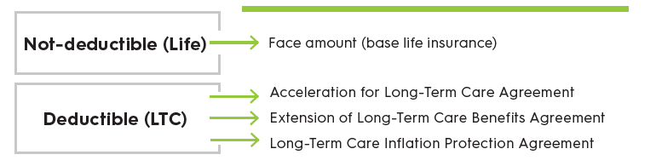
Two parts of a SecureCare product
Cash Value
No Cash Value
Notes:
IRC section 7702B(e)(1) and IRC Section 7702B(e)(2). Payments made for the policy are not eligible for the advantageous tax treatment if they are a “charge against the cash surrender value of a life insurance contract.”
SecureCare incorporates a separate Long-Term Care Agreement premium payment, rather than a charge.
The LTC agreements that are part of the SecureCare policy do not have cash value and the premiums for the LTC agreement portion of the contract are paid directly to Securian Financial for the LTC benefit.
Since Securian Financial charges a premium for the LTC agreement and that premium is never part of the cash value of the life insurance policy, our clients have a reasonable argument that they should be able to deduct those premiums, subject to the age-based limitations.

Slide 6
Individuals
Notes:
Next, let’s discuss income tax issues for individuals
There are three items we will discuss:
Three steps to determine if LTC premiums are deductible
Can you pay the LTC premium with a health savings account (HSA)?
Other tax concerns

Slide 7
Income tax deduction for LTC premiums – three steps
Notes:
Let’s start with income tax deduction for individuals paying their long term care premiums.
Please keep in mind, not everyone will qualify for the deduction
An easy method to discuss this with clients is using a three step process
Let’s start with step 1 on the next slide

Slide 8

Step 1: Determine the amount of LTC premium paid
Notes:
Step 1 is to determine the LTC premium, separate from the life insurance portion
For SecureCare, there are three parts of the premium that can be deducted:
[read the slide]

Slide 9
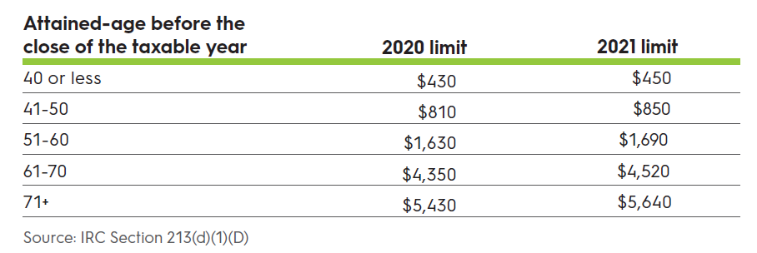
Step 2: Review age-based limitations
Notes:
Next, we need to review the age-based limitations.
These are limitations set by the IRS and are adjusted for inflation annually.
Please note that as an individual gets older the limitations increase

Slide 10
Step 3: Itemized deduction for medical expenses is the lesser of the LTC premium or age-based limit
Example 1: Mike, age 55
  Annual LTC premium: $5,000
  Age-based limit: $1,690
  Deduction = $1,690
Example 2: Mariana, age 72
  LTC premium: $5,000
  Age-based limit: $5,640
  Deduction = $5,000
These are hypothetical examples for illustrative purposes only.
Notes:
Step 3 is determining whether the lesser of the LTC premium or age-based limit will be the deduction.
Read through the examples.

Slide 11
Where are the itemized deductions?
Current income
− Above-the-line deductions
Adjusted gross income (AGI)
− Standard deduction OR itemized deduction
Taxable income
Notes:
So now you know the amount of the deduction. Where is the deduction on the form 1040?
This slide is a simplified outline of the Form 1040.
At the top is all current income. Next are the above the line deductions (this is important later for business owners) which gets the taxpayer to the adjusted gross income
After the adjusted gross income is calculated, the taxpayer has a choice of using the standard deduction or the itemized deduction.
The next slide discusses this choice

Slide 12
Standard deduction versus itemized deductions
Standard Deduction
Married filing jointly: $25,100
Single: $12,550
Itemized Deductions
Medical expenses
  7.5% AGI threshold
  LTC premiums and other expenses
State and local taxes
  $10,000 maximum
Mortgage interest deduction
Charitable deduction
  Up to 60% of AGI
Notes:
The most recent tax law simplified how most taxpayers will pay their taxes because the law almost doubled the standard deduction. Each taxpayer has the choice to use either the standard deduction or the itemized deduction with the decision based on where they will get the higher amount to deduct.
Standard deduction
This slide has the amounts of the standard deduction for this year. If the client has less in itemized deductions than the standard deductions then they will use the standard deductions.
In 2021, the standard deduction for married filing jointly is $25,100 and single is $12,550
Itemized Deduction
This is found in the Schedule A for the form 1040
There are four main itemized deductions:
Medical expenses – this is for medical expenses that were not reimbursed or paid out of pocket. Here is where the LTC premiums can be paid. Remember the deduction is the lesser of the premiums paid or the age-based limit
State and local taxes – tax law change – a federal law limits this amount to $10,000 (regardless if you are MFJ or single)
Mortgage interest
Charitable deduction – tax law change – it is now 60% of AGI for cash gifts (it was 50%)

Slide 13
Which clients will get the itemized deduction?
Clients who:
  are older (age-based limitations)
  have large amounts of out-of-pocket medical expenses
  live in states with high state taxes
  make large charitable gifts
  pay large amounts of mortgage interest
Notes:
Here is a list of clients who will likely be able to benefit from paying LTC premiums as an itemized deduction
Older ages – because of the age-based limitations (the older you are the more you are able to deduct)
Out-of-pocket medical expenses, high state tax, large charitable gifts and mortgage interest will increase the itemized deduction over the standard deductions

Slide 14
Health Savings Accounts and LTC premiums
Notes:
Next, let’s discuss health savings accounts (HSA) and LTC premiums

Slide 15
Can a Health Savings Account (HSA) be used to pay the premiums for a SecureCare policy?
Yes, premiums are a qualified medical expense
Only the LTC premiums (not life portion) can be paid from an HSA
Up to the age-based limits
Notes:
Yes, the LTC premiums can be paid from a Health Savings Account. But only the LTC portion (not the life insurance portion).

Slide 16
Example
Larry, age 67, pays $15,000 annual premium, for seven years, to a SecureCare policy and has $30,000 in his HSA account
  LTC portion of the premium: $5,407.33
  Age-based limit: $4,520
  Larry’s HSA pays: $4,520
  Larry pays (out of pocket): $10,480
This is a hypothetical example for illustrative purposes only.
Notes:
Read the slide
Larry pays (out of pocket): $10,650 ($1,057.33 for the remainder of the LTC portion + $9,592.67 for the life insurance base policy)

Slide 17
Other tax implications
Notes:
Let’s discuss a couple of other tax implications for SecureCare

Slide 18
Other tax implications
LTC Agreement payments will not be subject to income tax if:
  Up to the per diem limit ($400 in 2021)
  If it exceeds per diem, then must show documented qualified LTC expenses
May be a modified endowment contract (MEC)
1035 Exchanges are permitted
Death benefit is income tax free
Notes:
Payment not taxed
The LTC Agreement payments will not be income taxed if:
The payments are up to the annually adjusted per diem limit - $400 in 2021
If it exceeds, then the client will need to show documented qualified LTC expenses
MEC
A life insurance policy may become a MEC if it fails the 7-pay test. As a result, single pay or short-pay premium schedules will often result in a SecureCare policy becoming a MEC. When premiums are paid over a longer period, such as 10 to 15 years, this is less likely to occur. In addition, contracts that are a 1035 Exchange, when the original policy was not a MEC, may avoid becoming a MEC under the new contract.
Having a MEC status generally does not affect the purpose of a SecureCare policy:
Death proceeds are generally paid income-tax-free.
Qualified LTC benefits are generally received income-tax-free
MECs are only subject to income-taxation upon withdrawals or loans from the contract. Linked-benefit policies are not designed or intended for cash accumulation so withdrawals and/or loans are rarely taken. In addition, if taken, they may negatively affect the LTC benefits.
1035 Exchange
A 1035 Exchange allows a life insurance or annuity contract to be exchanged for a new policy without recognizing taxable gain on the exchange. Additionally, the new policy takes the income-tax basis of the old policy.
The Pension Protection Act (PPA) expanded IRC Section 1035 to permit non-qualified life insurance and annuity contracts to be exchanged for a qualified LTC policy. This includes linked-benefit products with qualified LTC benefits; however it is important to note that these rules were not expanded to allow an annuity contract be exchanged into a linked-benefit (life) contract.
Partial 1035 exchanges are permitted resulting in two contracts – the old life or annuity contract with a lesser value, and a new LTC product using the remaining value to fund the required premium to put the policy inforce.
It is important to note that the PPA prohibits an individual LTC policy from being exchanged into another individual LTC policy.
Death Benefit
Death benefit will remain income tax free because it is part of the life insurance portion of the SecureCare policy

Slide 19
Business-sponsored arrangements
Notes:
Let’s move to business sponsored arrangements
Please note – Clients must be mindful of discriminatory benefits in the employment setting. If they only offer benefits to only a select employees without defining a class of employee who will be offered the benefit and the benefit is only for the highly compensated employees, then this may invite scrutiny of the IRS.
The tax benefits from this section are based on the Internal Revenue Code Section 105 – Amounts received under accident and health plans
Please check the business’s legal and/or tax professionals on the eligibility of these income tax benefits.
Please note – These benefits can also be included for spouses and dependents of business owners and employees. Please check with client’s tax professional on the legal and/or tax implications on extending the benefit to these individuals.

Slide 20
Pass-through entities
Notes:
Let’s start with pass-through entities.

Slide 21





Pass-through entity owners
One level of taxation: business income “passes through” to the owner
Business pays premium to Securian Financial (deductible to owner as an above the line deduction – lesser of LTC premium or age-based limitation)
Securian Financial applies premium to a policy on the owner
Notes:
An important aspect of pass-through entity taxation is there is only one level of taxation and all business income “passes though” to the business owner.
If the business pays the premium for the business owner (also an employee), then the owner will be able to make the deduction as an above the line deduction.
This deduction is the lesser of the LTC premium or the age-based limit.

Slide 22
Where are the above-the-line deductions?
Current income
- Above-the-line deductions
Adjusted gross income
- Standard deduction OR itemized deduction
Taxable income
Notes:
Remember we discussed itemized deductions previously, here we see how above-the-line deductions are typically more beneficial than itemized deductions for pass-through entity owners.
Again, this is a simplified outline of the Form 1040. At the top is all current income, next are the above the line deductions (this is where the business owner gets the deduction) which gets the taxpayer to the adjusted gross income.

Slide 23
Pass-through entities
Entity | Business tax deductions | Premium payments included in income | Income tax deduction
S corporation | As compensation | Both life and LTC portions included | Above-the-line, as self-employed health insurance deduction
Partnership | As guaranteed payments
Sole proprietor | As compensation
Notes:
There a couple of different pass-through entities. Here is how the business tax deductions are taxed.
[read the slide]

Slide 24
Case study: Bruce (S corporation owner)
Bruce (age 47) is employee/owner of XYZ Corporation (S corporation) and has two employees
He wants to provide SecureCare to both himself and his employees
XYZ is willing to pay $10,000 premiums for 15 years for Bruce
  Male (age 47) with non-tobacco underwriting rating
  6-year benefit: 2-year Acceleration for Long-Term Care Agreement and 4-year Extension of Long-Term Care Benefits Agreement
  3% Compound Long-Term Care Inflation Protection Agreement
This is a hypothetical example for illustrative purposes only.
Notes:
Let‘s go through an example.
[Read the slide]

Slide 25
Case study: Bruce tax implications
$150,000 premium paid over 15 years
  Annual premium: $10,000
    Face amount: $5,034.38
    Acceleration for Long-Term Care Agreement: $861.61
    Extension of Long-Term Care Agreement: $651.33
    Long-Term Care Inflation Protection Agreement: $3,452.68
Year | LTC Premium | Age-based (assuming no inflation) | Lessor of: (Above-the-line deduction)
1 (Age 47) | $4,965.62 | $850 | $850
5 (Age 51) | $4,965.62 | $1,690* | $1,690*
15 (Age 61) | $4,965.62 | $4,520* | $4,520*
This is a hypothetical example for illustrative purposes only.
Notes:
Read through the example.
Remember, it is the lesser of aged-based limit or premium paid.
Notice on the chart below that the older Bruce gets the more of a deduction he will receive because of the age-based limitations increase the older the client gets.

Slide 26
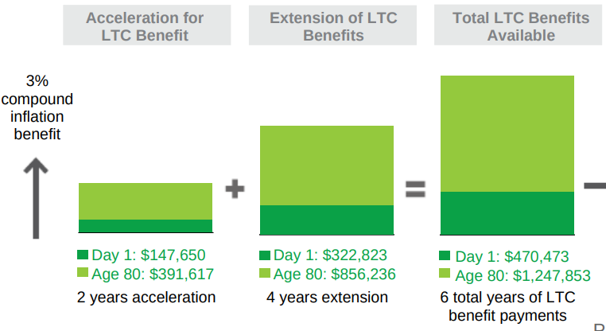
Case study: guarantee #1 – if Bruce needs long-term care
Plus, $10,000 death benefit paid to Bruce’s beneficiaries income tax free
This is a hypothetical example for illustrative purposes only.
Notes:
Read slide

Slide 27
Case study: guarantees #2 and #3
If Bruce dies before needing LTC
If Bruce wants his money back, full return of premium beginning in year 16²
Minimum amount paid income tax-free to Bruce’s beneficiary(ies)¹
$150,000
$150,000
Paid to Bruce
¹This figure represents the death benefit we calculate taking into consideration the premium paid that is allocated to the death benefit and applicable requirements under the IRC. The amount paid will be reduced by any terminal illness benefit payments, premium due, partial surrenders, and any indebtedness.
² Upon surrender, the policy owner will receive the surrender value proceeds. The surrender value proceeds may not equal the sum of premiums paid. Surrenders are subject to a return of premium vesting schedule. Policies that are fully vested are eligible for a full return of all premiums paid.
This is a hypothetical example for illustrative purposes only.
Notes:
Read slide

Slide 28
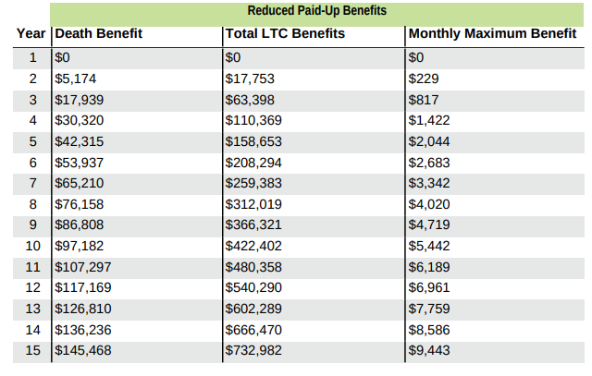
Case study: guarantee #4 – if XYZ provides no additional premiums
1
¹Reduced paid-up benefits refers to the reduced paid-up nonforfeiture benefit that purchases paid-up insurance in the event of premium lapse.
This is a hypothetical example for illustrative purposes only.
Notes:
[read the slide]
The reduced paid-up benefits would purchase a death benefit and LTC benefit amount. And because inflation is included in the policy, this will continue to inflate the pool after the RPU is put into place.

Slide 29
C corporation owners
Notes:
Let’s turn our attention to C corporation owners

Slide 30
Tax law opportunity: C corporations
Two levels of taxation for shareholders:
  NEW business income: 21% rate (decrease of up to 14%)
  Shareholder income: dividend (qualified → long term capital gains)
Business has more retained earnings than the past
Shareholders looking for tax-efficient methods to take income from business
Notes:
Let’s move to C corporations. They are taxed differently than pass-through entities because there are two levels of taxation.
Tax law change – New business income tax rate is a flat 21%, this may be a decrease of 14% for some C corporations. It also means that they have more cash in the corporation. The challenge is how to get the cash out to the owners in the most tax-efficient manner.
In general, the cash coming out of the business is either compensation (ordinary income) or qualified dividend (long term capital gains).
One tax-efficient solution is to take earnings from the business by paying the owner (who is also an employee) and employees to pay for SecureCare premium payments.

Slide 31
C corporation owners
Business pays premium (fully deductible) to Securian Financial
Securian Financial applies premium to a policy on the owner*
  Life insurance part is includible in income
  LTC part is not includible in income
If not an employee, no business deduction and included in shareholder’s income
* Plus spouses and dependents of owner/employee.
Notes:
How is the income-tax deduction, if any, for a C corporation for the LTC portion of the link-benefit life insurance product handled?
The entire premium associated with the purchase of a linked-benefit product, such as SecureCare, is income-tax deductible as compensation. Under IRC section 264, the company may not have either a direct or an indirect benefit from the product to be eligible for the deduction. The deduction applies for purchase of a qualified long-term care contract for its employees, and their spouses or dependents.
For shareholders, the deduction may only be taken if the long-term coverage is provided to the shareholder as an employee of the C corporation. The deduction is not limited to the attained-age cap eligible premium amounts.
The portion of the total premium associated with the long-term care coverage may be excluded from income under IRC Section 106. This section allows employer-provided coverage under an accident and health plans to be excluded from income.
This exclusion rule includes amounts paid to the taxpayer, and the taxpayer’s spouse and dependents as defined by IRC Section 152 without regard to subsections (b)(1), (b)(2), and (d)(1)(B) of IRC Section 152. Of course, the employee is prohibited from taking an income-tax deduction on Form 1040, Schedule A for that part of the premium. The portion of the total premium associated with the life insurance coverage must be included in income
Business deductibility of the premium
LTC premiums are treated similarly to health insurance premiums (100% income tax deductible)
Must have a valid class of employees
Can include owner, owner’s spouse and dependents
Income tax consequences to the insured
Excluded from gross income because premiums are considered medical care
Not limited to the attained-age limits
What about a shareholder who is not an employee of the C corporation
Business deductibility of the premium
Taxed as income from the business to the owner
Income characterized depends on the situation and type of entity
No income tax deduction for LTC premiums paid
Income tax consequences to the insured
Includable in income
Potentially deductible on the form 1040 as an itemized deduction (subject to attained-age limits) and threshold limits

Slide 32
Case study: ABC Corporation
ABC Corporation (C corporation)
  Business income of $1 million in 2019 → $790,000 after tax
  30 employees
  Have valid class of employees for LTC benefits
Nancy (age 60): employee and 50% owner of ABC Corporation
Paul (age 50): not employee and 20% owner of ABC Corporation
This is a hypothetical example for illustrative purposes only.
Notes:
For example, let’s take ABC Corporation…
[Read the slide]

Slide 33
Case study: Nancy (C corporation)
ABC is interested in providing SecureCare product solutions and Nancy is part of the valid class of employees
  ABC will pay premiums of $20,000 for 5 years for a SecureCare policy on Nancy which she will own
  Female, age 60, non-tobacco underwriting rating, couples discount
  6-year benefit: 2-year Acceleration for Long-Term Care Agreement and 4-year Extension of Long-Term Care Benefits Agreement
  5% Compound Long-Term Care Inflation Protection Agreement
This is a hypothetical example for illustrative purposes only.
Notes:
Read the slide

Slide 34
Case study: Nancy (C corporation)
Nancy
Annual business tax deduction of $20,000
Includes $5,057.03 in income
$100,000 in premium paid over 5 years
  Annual premium: $20,000
    Face amount: $5,057.03
    Acceleration for Long-Term Care Agreement: $1,835.52
    Extension of Long-Term Care Agreement: $1,351.92
    Long-Term Care Inflation Protection Agreement: $11,755.46
This is a hypothetical example for illustrative purposes only.
Notes:
Business deductibility of the premium
LTC premiums are treated similarly to health insurance premiums (100% income tax deductible)
Life portion will be treated as an executive bonus to Nancy (deductible to business and included in Nancy’s income)
Must have a valid class of employees
Can include owner, owner’s spouse and dependents
Income tax consequences to the insured
Excluded from gross income because premiums are considered medical care
Life portion will be treated as an executive bonus to Nancy (deductible to business and included in Nancy’s income)
Not limited to the attained-age limits

Slide 35
Case study: Paul
Paul is interested in purchasing a SecureCare policy
Pay premiums of $20,000 for 5 years
  Male (age 50) non-tobacco underwriting rating
  6-year benefit: 2-year Acceleration for Long-Term Care Agreement and 4-year Extension of Long-Term Care Benefits Agreement
  5% Compound Long-Term Care Inflation Protection Agreement
This is a hypothetical example for illustrative purposes only.
Notes:
Read the slide

Slide 36
Case study: Paul (C corporation)
Paul
Paul
No tax deduction
Includes $20,000 in income
$100,000 in premium paid over 5 years
  Annual premium: $20,000
    Face amount: $6,924.59
    Acceleration for Long-Term Care Agreement: $1,195.95
    Extension of Long-Term Care Agreement: $897.31
    Long-Term Care Inflation Protection Agreement: $10,982.25
This is a hypothetical example for illustrative purposes only.
Notes:
Business deductibility of the premium
Taxed as income from the business to the owner
Income characterized depends on the situation and type of entity
No income tax deduction for LTC premiums paid
Income tax consequences to the insured
Includable in income
Potentially deductible on the form 1040 as an itemized deduction (subject to attained-age limits) and threshold limits

Slide 37
Employees

Slide 38
Employees
Employee
Business pays premium (fully deductible) to Securian Financial
Securian Financial applies premium to a policy on the employee
  Must have a valid class of employees
  Life insurance part is includible in income
  LTC part is not includible in income
Please note: Employees of sole proprietorships are different. Taxable to employee and above-the-line deduction for owner.
Notes:
Business deductibility of the premium
LTC premiums are treated similarly to health insurance premiums (100% income tax deductible)
Must have a valid class of employees
Can include owner, owner’s spouse and dependents
Income tax consequences to the insured
Excluded from gross income because premiums are considered medical care
Not limited to the attained-age limits

Slide 39
Case study: Chuck (employee)
Chuck (age 55) is an employee of Widget Inc.
Widget Inc. wants to provide a long-term care solution to Chuck and other employees (valid class)
  Widget is willing to pay $10,000 for 7 years for a male (age 55) with non-tobacco underwriting rating
  6-year benefit: 2-year Acceleration for Long-Term Care Agreement and 4-year Extension of Long-Term Care Benefits Agreement
  With 3% Compound Long-Term Care Inflation Protection Agreement
This is a hypothetical example for illustrative purposes only.
Notes:
Read the slide

Slide 40
Case Study: Chuck (employee)
Chuck
Chuck
Annual business tax deduction of $10,000
Includes $5,473.13 in W-2 income
$70,000 in premium paid over 7 years
  Annual premium: $10,000
    Face amount: $5,473.13
    Acceleration for Long-Term Care Agreement: $961.73
    Extension of Long-Term Care Agreement: $711.61
    Long-Term Care Inflation Protection Agreement: $2,853.56
This is a hypothetical example for illustrative purposes only.
Notes:
Read the slide

Slide 41
Any questions?

Slide 42
SecureCare may not cover all of the costs associated with long-term care or terminal illness the insured incurs. This product is generally not subject to health insurance requirements. This product is not a state-approved Partnership for Long Term Care Program product, and is not a Medicare Supplement policy. Receipt of a long-term care or terminal illness benefit payment under this product may adversely affect eligibility for Medicaid or other government benefits or entitlements.
SecureCare Universal Life Insurance includes the Acceleration for Long-Term Care Agreement. The Acceleration for Long-Term Care Agreement and Extension of Long-Term Care Benefits Agreements are tax qualified long-term care agreements that cover care such as nursing care, home and community based care, and informal care as defined in these agreements. These agreements provide for the payment of a monthly benefit for qualified long-term care services. These agreements are intended to provide federally tax qualified long-term care insurance benefits under Section 7702B of the Internal Revenue Code, as amended. However, due to uncertainty in the tax law, benefits paid under these agreements may be taxable.
This material may contain a general analysis of federal tax issues. It is not intended for, nor can it be used by any taxpayer for the purpose of avoiding federal tax penalties. This information is provided to support the promotion or marketing of ideas that may benefit a taxpayer. Taxpayers should seek the advice of their own tax and legal advisors regarding any tax and legal issues applicable to their specific circumstances.
Guarantees are subject to the terms and conditions of the policy and the financial strength and claims-paying ability of the issuing company.
The death proceeds will be reduced by a long-term care or terminal illness benefit payment under this policy. Please consult a tax advisor regarding long-term care benefit payments, terminal illness benefit payments, or when taking a loan or withdrawal from a life insurance contract
Life insurance products contain fees, such as mortality and expense charges, and may contain restrictions, such as surrender periods.
The optional Long-Term Care Inflation Protection Agreement is available with 3% simple interest, 3% compound interest, 5% simple interest or 5% compound interest.
Additional agreements may be available. Agreements may be subject to additional costs and restrictions. Agreements may not be available in all states or may exist under a different name in various states and may not be available in combination with other agreements.
Products may not be available in all states. Product features, including limitations and exclusions, may vary by state
These are general marketing materials and, accordingly, should not be considered investment advice or a recommendation that any particular product or feature is appropriate or suitable for any particular individual. These materials are based on hypothetical scenarios and are not designed for any particular individual or group of individuals (for example, any demographic group by age or occupation). The materials were prepared for financial professionals who are experienced in investment and/or insurance matters. As a result, they should not be reviewed or relied on by any other persons. Securian Financial Group, and its affiliates, have a financial interest in the sale of their products.
INSURANCE PRODUCTS ISSUED BY MINNESOTA LIFE INSURANCE COMPANY or Securian Life Insurance Company, a New York authorized insurer. Minnesota Life is not an authorized New York insurer and does not do insurance business in New York. Both companies are headquartered in Saint Paul, MN. Product availability and features may vary by state. Each insurer is solely responsible for the financial obligations under the policies or contracts it issues.
Securian Financial is the marketing name for Securian Financial Group, Inc., and its affiliates. Minnesota Life Insurance Company and Securian Life Insurance Company are affiliates of Securian Financial Group, Inc. Securian Financial is the marketing name for Securian Financial Group, Inc., and its affiliates.
For financial professional use only. Not for use with the public. This material may not be reproduced in any way where it would be accessible to the general public.
securian.com
400 Robert Street North, St. Paul, MN 55101-2098
©2019 Securian Financial Group, Inc. All rights reserved.
SECURECARETAX Rev 1-2021 DOFU 1-2019
704341

